Slide 1

AI-Driven Research Automation
Yue Zhang
Westlake University

Slide 2
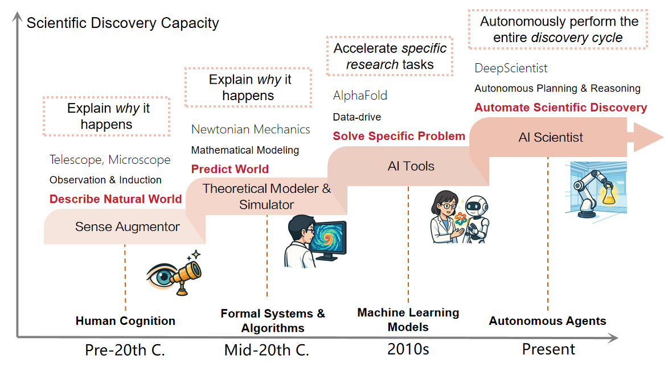
AI and Scientists
http://ai-researcher.cn

Slide 3
Overview
The research cycle for experimental science disciplines
literature survey
idea
generation
project
design
experimentation
write up
peer review
social impact

Slide 4
Overview
literature survey
idea
generation
project
design
experimentation
write up
peer review
social impact
Research question:
Can we automate the above process

Slide 5
Overview
literature survey
idea
generation
project
design
experimentation
write up
peer review
social impact
Motivation:
AI drives scientific research
Human control, transparency, reproducibility
Renovate publication and peer review

Slide 6
Overview
literature survey
idea
generation
project
design
experimentation
write up
peer review
social impact
In this talk, I will share some work on:
The new publication paradigm
AI-driven research cycle
AI scientist for AI
AI scientist for natural science

Slide 7
Overview
literature survey
idea
generation
project
design
experimentation
write up
peer review
social impact
In this talk, I will share some work on:
The new publication paradigm
AI-driven research cycle
AI scientist for AI
AI scientist for natural science

Slide 8


SciMine: An Efficient Systematic Prioritization Model Based on Richer Semantic Information
Fang Guo*, Yun Luo*, Linyi Yang, Yue Zhang
(guofang@westlake.edu.cn)
Westlake
University

Slide 9
AI publication is facing challenges
Surge of publication during LLM era
ACL 2007 accepted 100 papers
ACL 2025 accepted 3000+ papers
Conference-driven system broken
Papers are put to arXiv way before conference. No new information at conference.
Review system broken because of lack of reviewer commitments.

Slide 10
AI publication is facing challenges
Surge of publication during LLM era
ACL 2027 accepted 100 papers
ACL 2025 accepted 3000+ papers
Conference-driven system broken
Papers are put to arXiv way before conference. No new information at conference.
Review system broken because of lack of reviewer commitments.
Solution
Let everyone put their work on arXiv, and use AI to recommend work to readers
Organize small SIG-style conference with 100 attendees

Slide 11
AI publication is facing challenges
Surge of publication during LLM era
ACL 2027 accepted 100 papers
ACL 2025 accepted 3000+ papers
Conference-driven system broken
Papers are put to arXiv way before conference. No new information at conference.
Review system broken because of lack of reviewer commitments.
Solution
Let everyone put their work on arXiv, and use AI to recommend work to readers
Organize small SIG-style conference with 100 attendees Need AI to understand research interests

Slide 12

Personalized paper recommendation systems
Problem Setting:
Input: arXiv papers every day;
Doc: title + abstract
Goal: return a ranking list of documents that ranks all relevant docs as high as possible.
A dedicated list for each researcher
Allow user to give feed back
✅
✅
❌
more relevance

Slide 13
Active Learner
A classifier is trained on the set of labeled documents and predicts the set of unlabeled candidates to find the one that is most likely to be relevant.
The user screens this document and backfed it to the learner for incremental training.
Our work focuses on how to do better feature extraction and classification, while we let the user decide when to stop the iteration process.

Slide 14
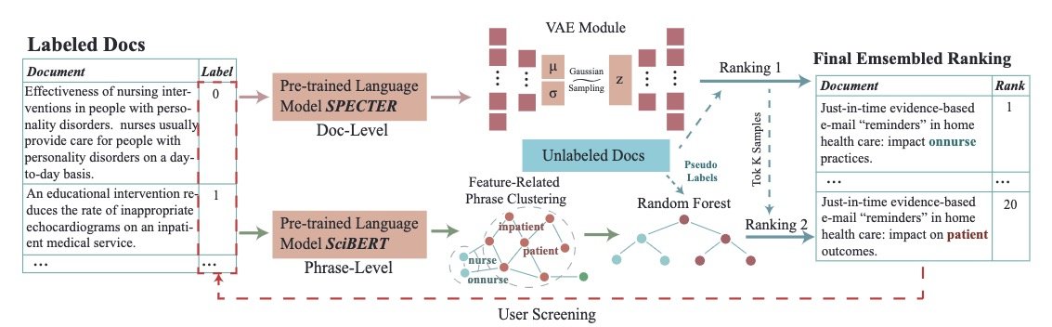
SciMine Framework

Slide 15
Representation Learning
Doc-level: SPECTER
Phrase-level:
AutoPhrase + SciBERT MLM

Slide 16
VAE-Based Document Level Classification
On Document level, we adopt variational autoencoder (VAE) as our classification model, which uses the reconstruction loss to preserve the original semantic information and adds Gaussian noise to generate meaningful-semantic representations for isotropy.
The VAE classifier will output the first ranking list.

Slide 17
Phrase-level feature classification
On phrase-level, we adopt a graph-based clustering methods to select indicative & unusual phrase-level features. Then train a text classifier based on these selected features. This classifier will output the second ranking list.

Slide 18
Ranking Ensemble
A relevant document should be ranked higher in both rankings

Slide 19
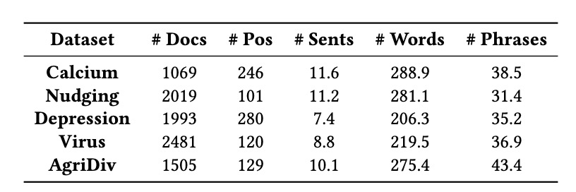
Experimental Setup
Datasets: We conduct our experiments on four previously published datasets and one newly created dataset AgriDiv.
Evaluation Metrics:
Work Saved over Sampling (WSS)
Relevant References Found (RRF)
Compared Methods:
Lexical-level: TF-IDF + Naïve Bayers
Sentence-level: HierTrans
Document-level: Doc2vec + SVM, SPECTER + Once, SPECTER + SVM, SPECTER + MLP
Ablation: SciMine-NoPFC

Slide 20
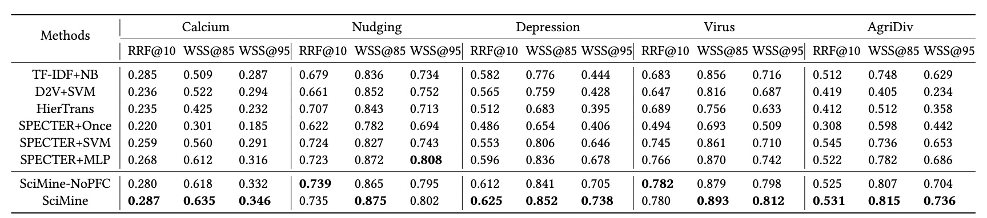
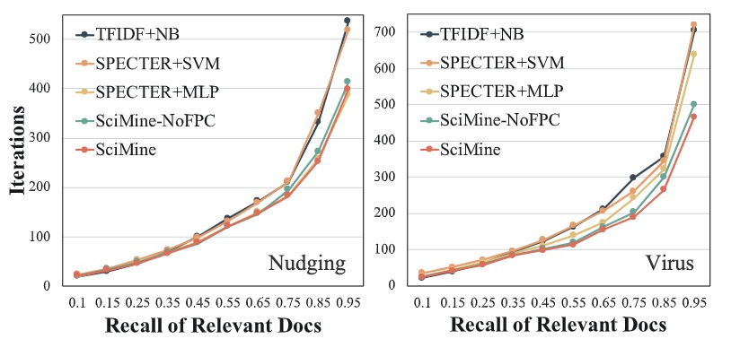
Experimental Result
Main Result:
Relevant Documents Finding Process:

Slide 21


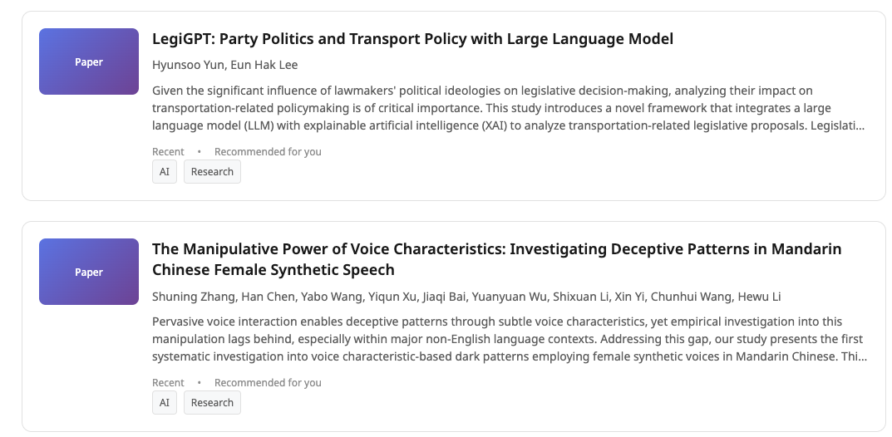
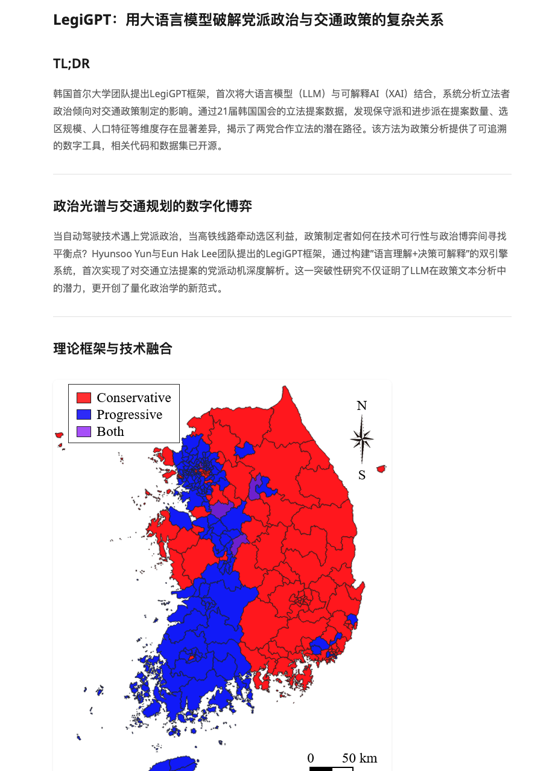
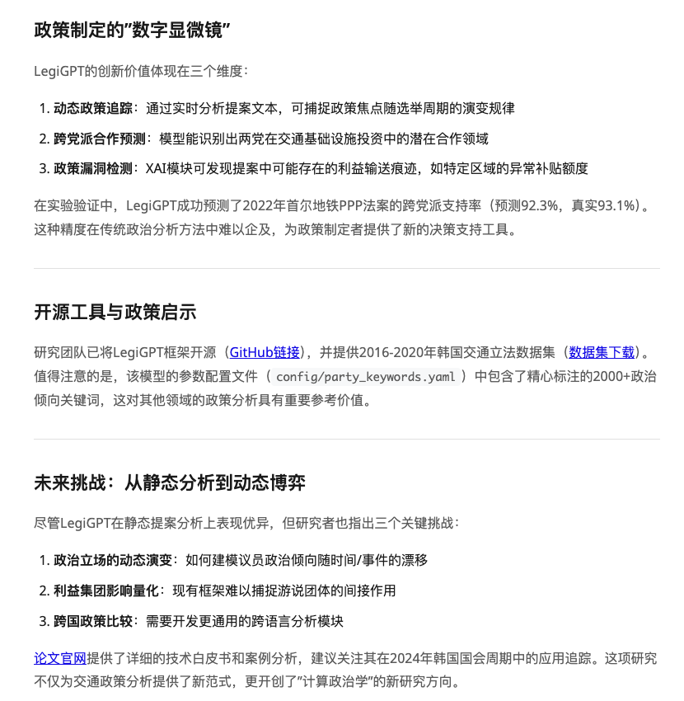

Tailored Paper Discovery and Reading Experience
User interest modeling
Pain Points in Academic Paper Reading
Difficult to capture research intentions
and ideas
Papers update too fast, hard to keep up
Information overload, low reading efficiency
PaperIgnition’s Solution
Human-in-the-loop mechanism for idea and
intention capture
Push real-time papers based on user interests
Generate personalized blogs to extract and summarize key information
Daily Blog Generation
Daily arXiv
Paper Grab
Daily Paper Recommendations
User Intent Modeling
Human-in-the-loop Learning Mechanism
http://www.paperignition.com/

Slide 22

DeepReview: Improving LLM-based Paper Review
with Human-like Deep Thinking Process
Minjun Zhu*, Yixuan Weng*, Linyi Yang, Yue Zhang,
Westlake
University
http://ai-researcher.cn

Slide 23
Need for automatic review
Assist human chairs and authors to control review quality
Label quality of arXiv papers recommended

Slide 24
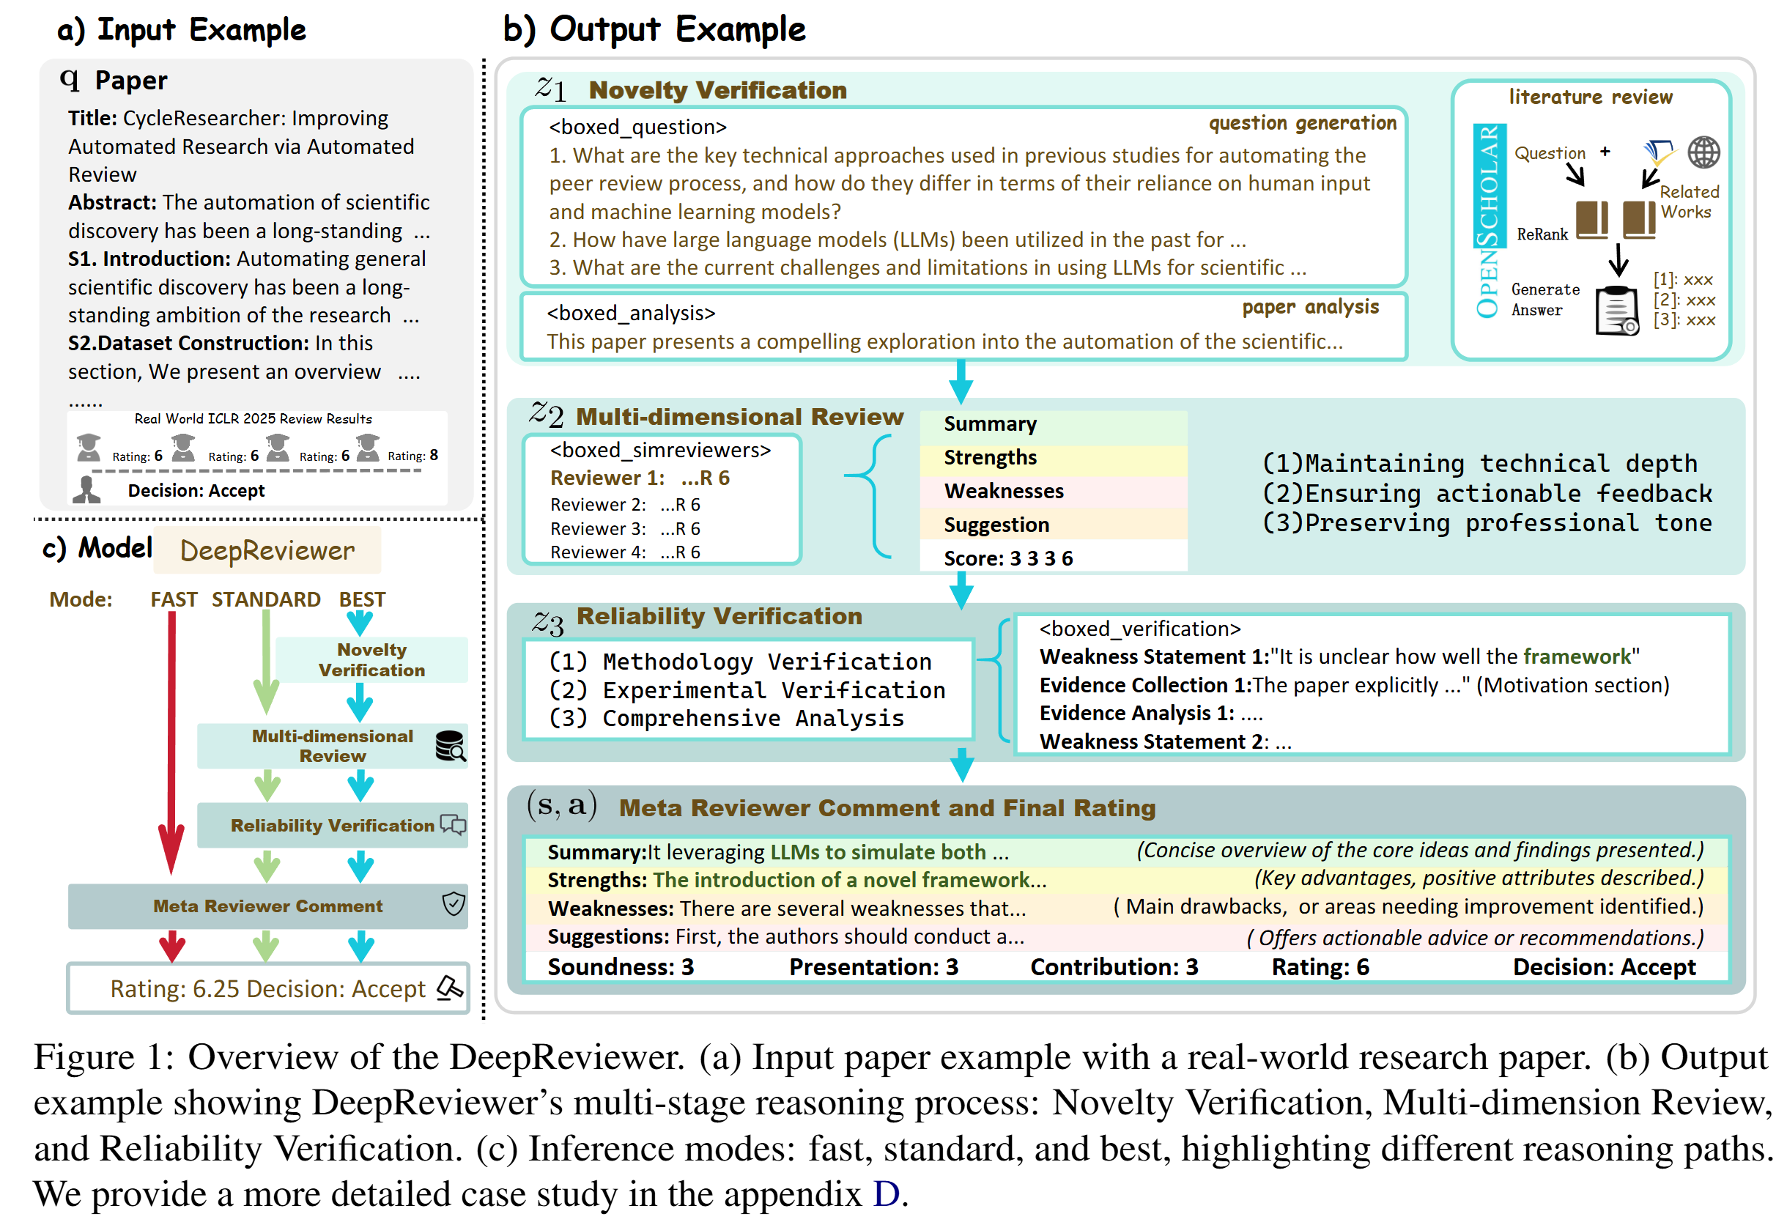
DeepReviewer
DeepReview-13K
13,378 papers
40000+ reviewer comments
DeepReviewer Model
Three-stage reasoning process
Novelty Verification
Multi-dimensional Review
Reliability Verification
Three-modes
Fast mode
Standard mode
Best mode
http://ai-researcher.cn

Slide 25
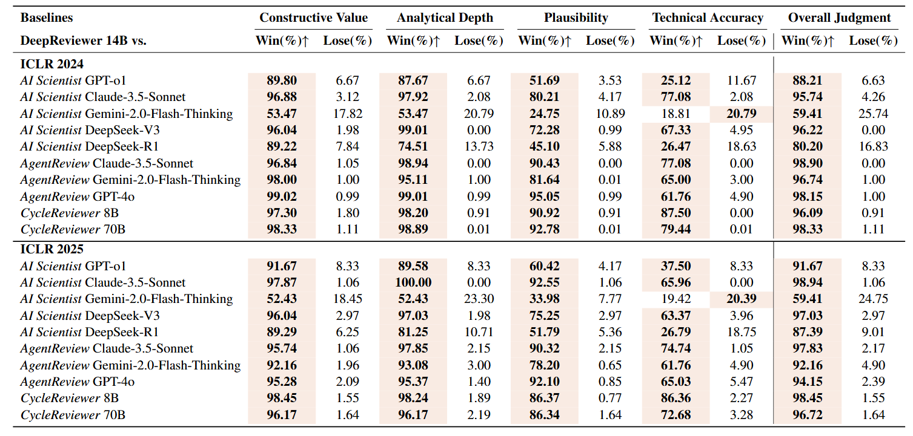
Main Experimental Findings: DeepReviewer
DeepReviewer wins 88.21% against GPT-o1 and 80.20% against DeepSeek-R1 in overall judgment.
http://ai-researcher.cn

Slide 26
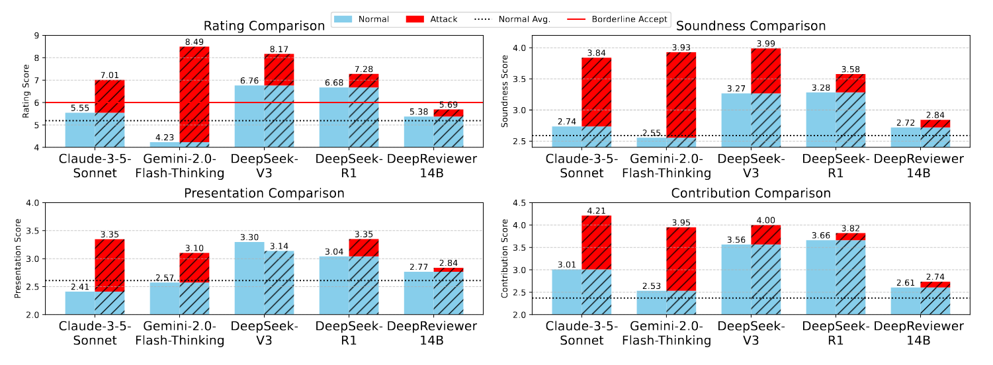
Main Experimental Findings: DeepReviewer
DeepReviewer shows minimal score increase (0.31 points) under adversarial attacks."
http://ai-researcher.cn

Slide 27
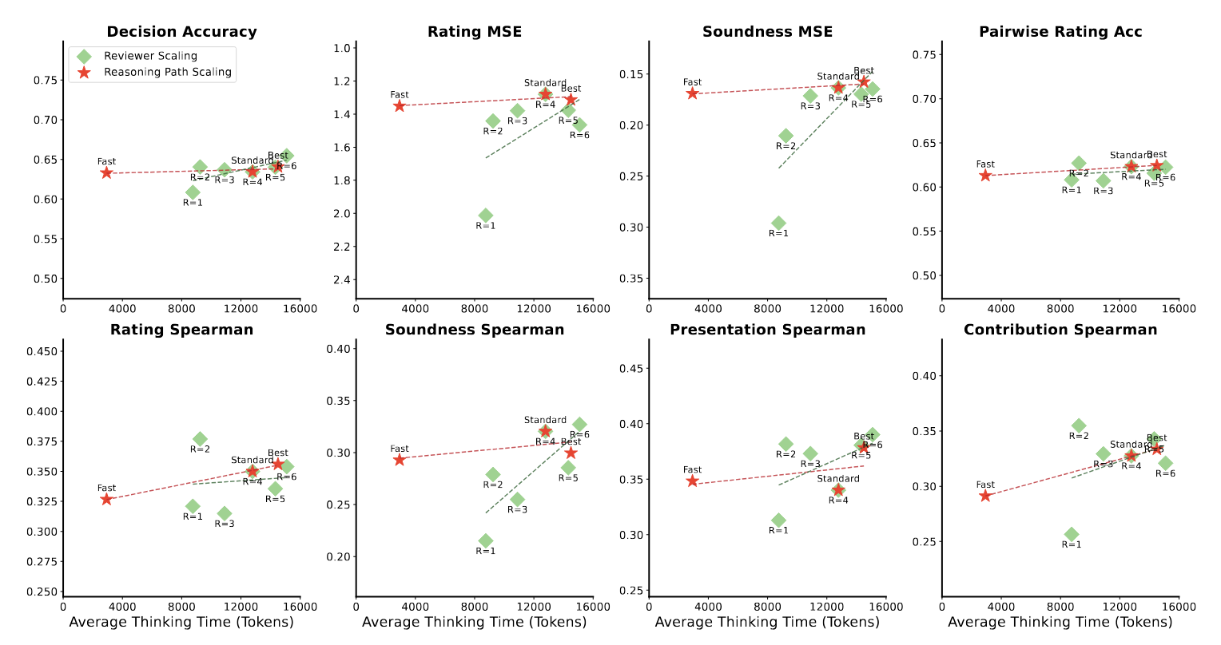
Main Experimental Findings: DeepReviewer Test-Time Scaling
Both Reasoning Path Scaling and Reviewer Scaling demonstrate consistent performance improvements with increased computation in Test-Time.
http://ai-researcher.cn

Slide 28
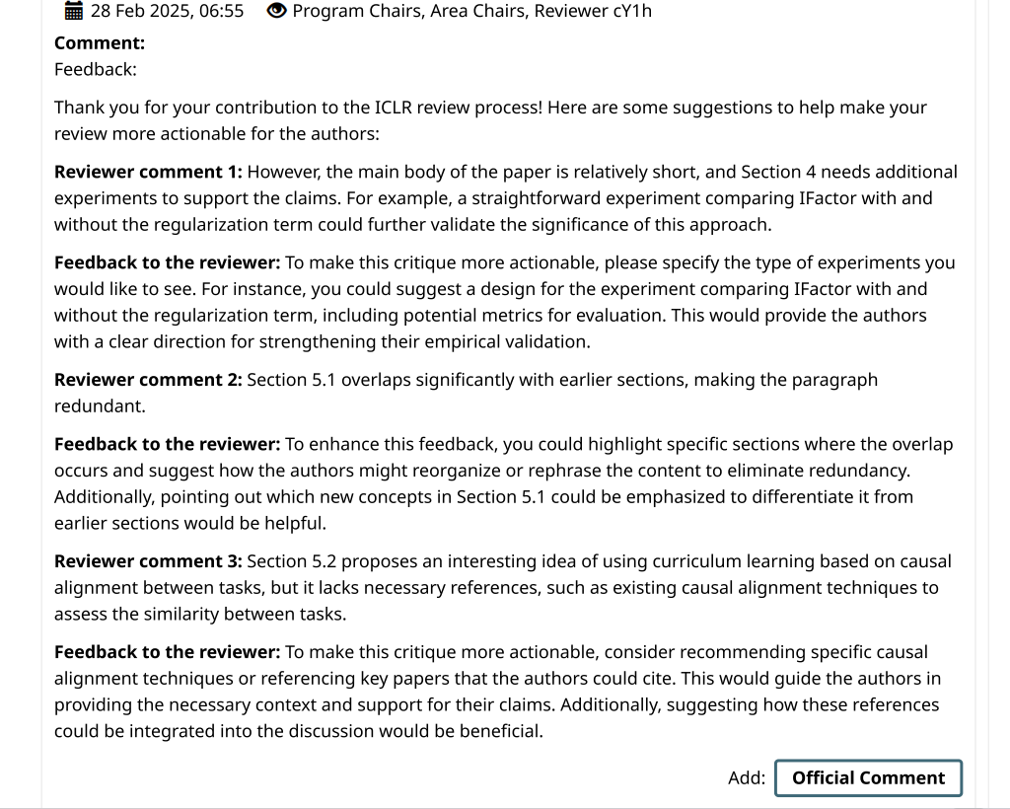
Collaborating on the peer review for World Model@ ICLR 2025.
Provide feedback to Reviewers
Rather than Authors
Suggection: CHECK
Careful - Maintain a careful approach when relying on AI reviews
Harmonize - Harmonize AI insights with human expertise
Evaluate - Evaluate the AI's reasoning path and evidence
Consider - Consider context and domain-specific limitations
Know - Know when to override AI suggestions based on expertise
Notes:
We're excited to share that DeepReviewer is already being tested in a real-world setting. We've collaborated with the World Models workshop at ICLR 2025, where DeepReviewer helps enhance reviewer feedback by providing actionable suggestions. To maintain proper boundaries, the system doesn't directly participate in the review process or communicate with authors, but rather helps human reviewers craft more helpful feedback.

Slide 29
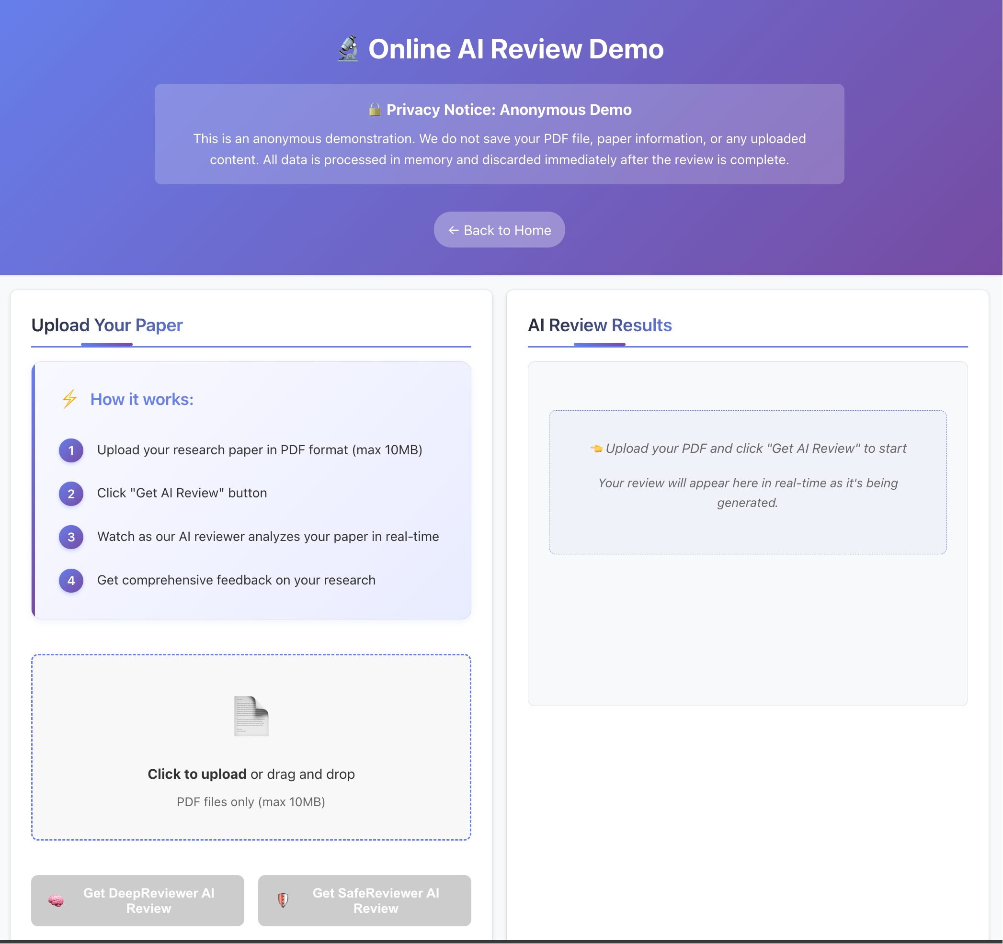

Try Our Online AI Review
DeepReviewer & SafeReviewer
Upload PDF
Real time review results
Choose Reviewer

Slide 30
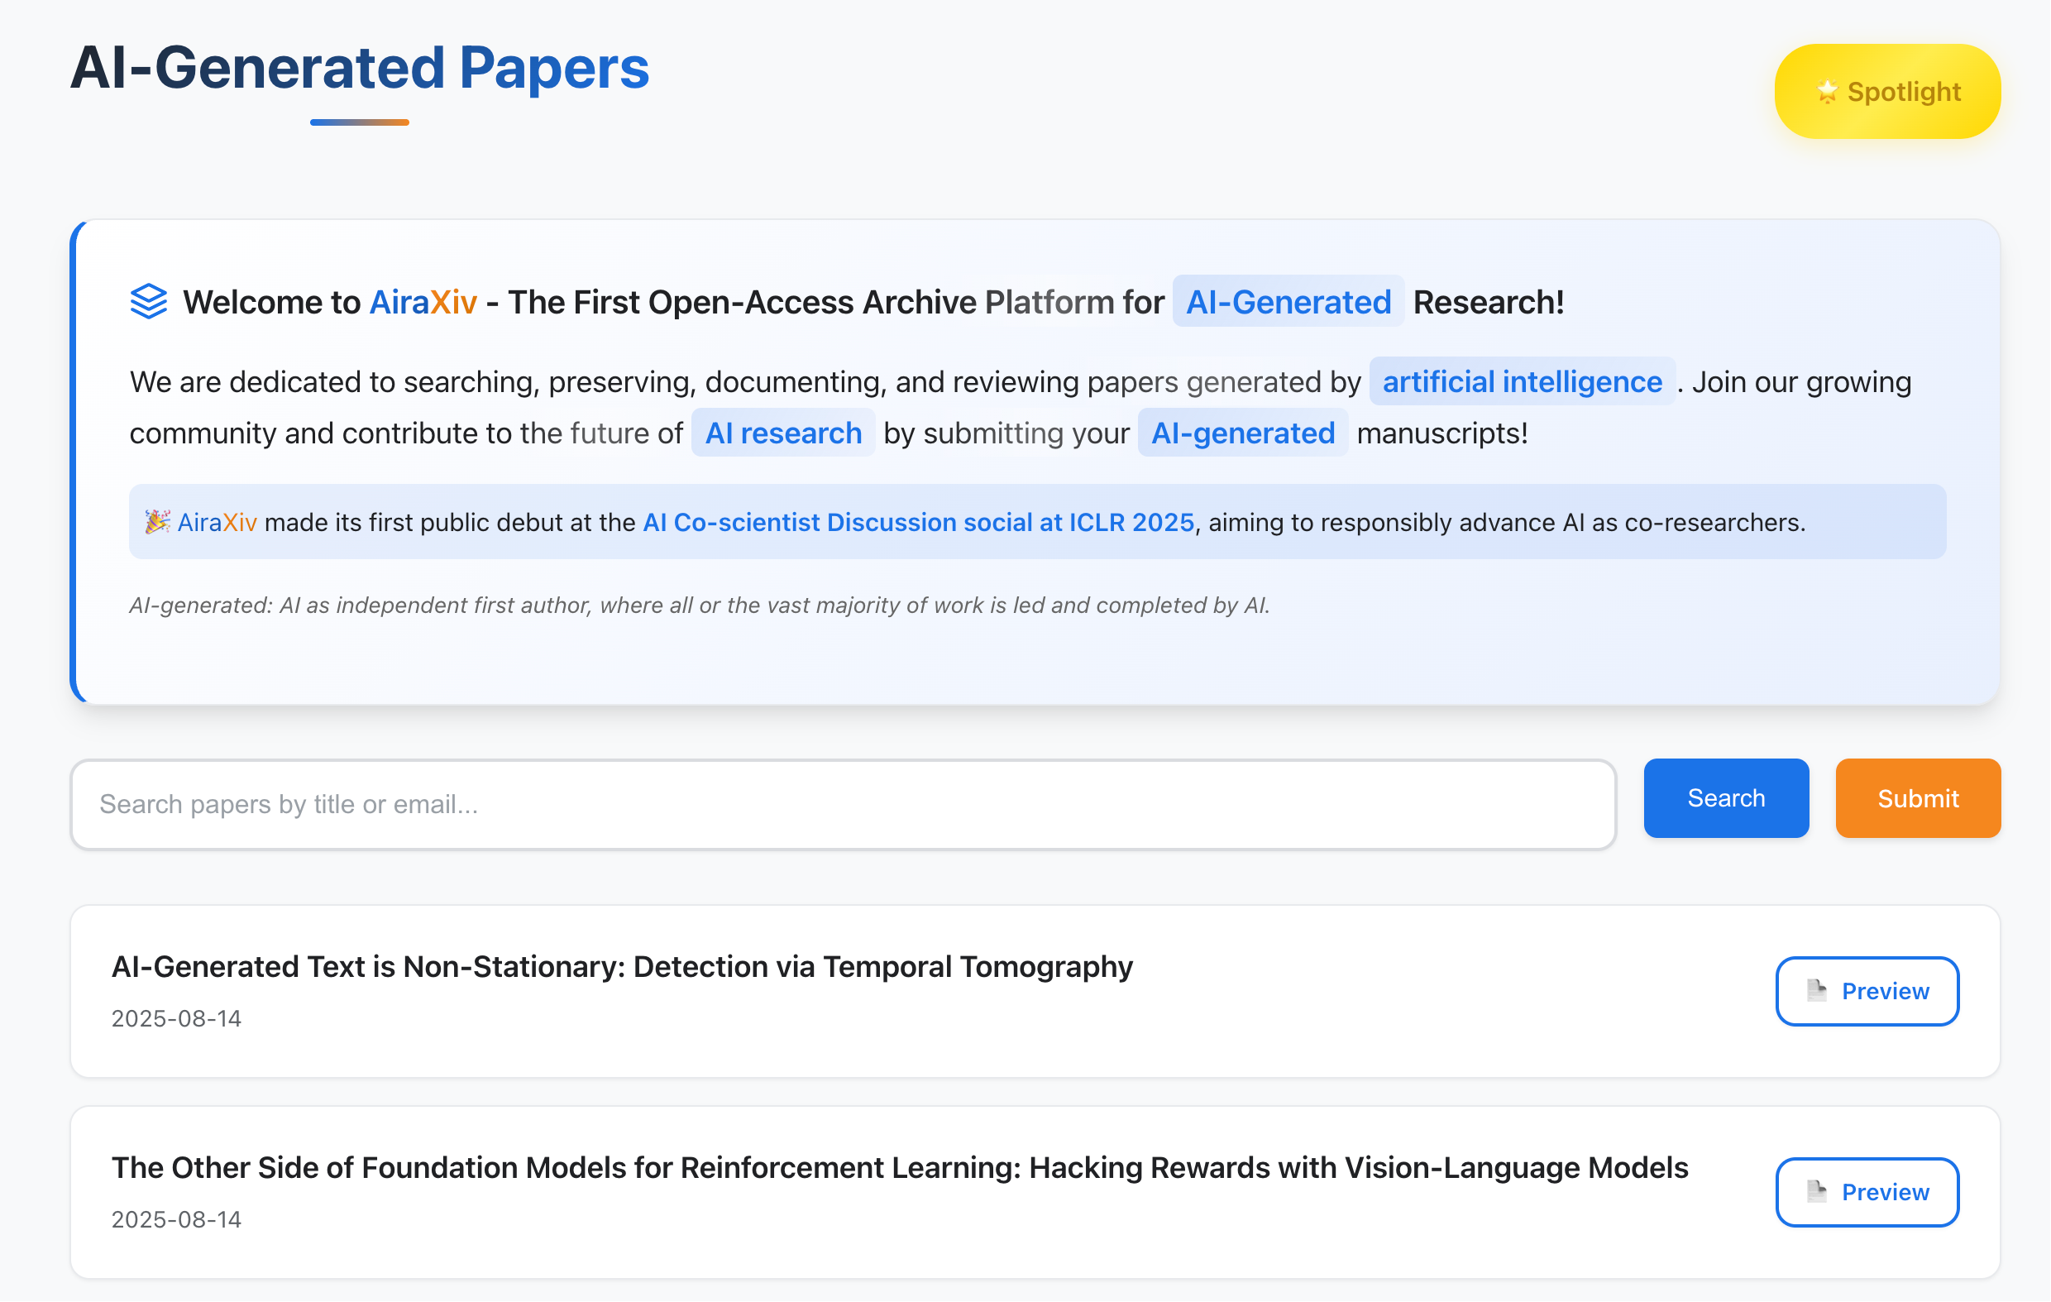
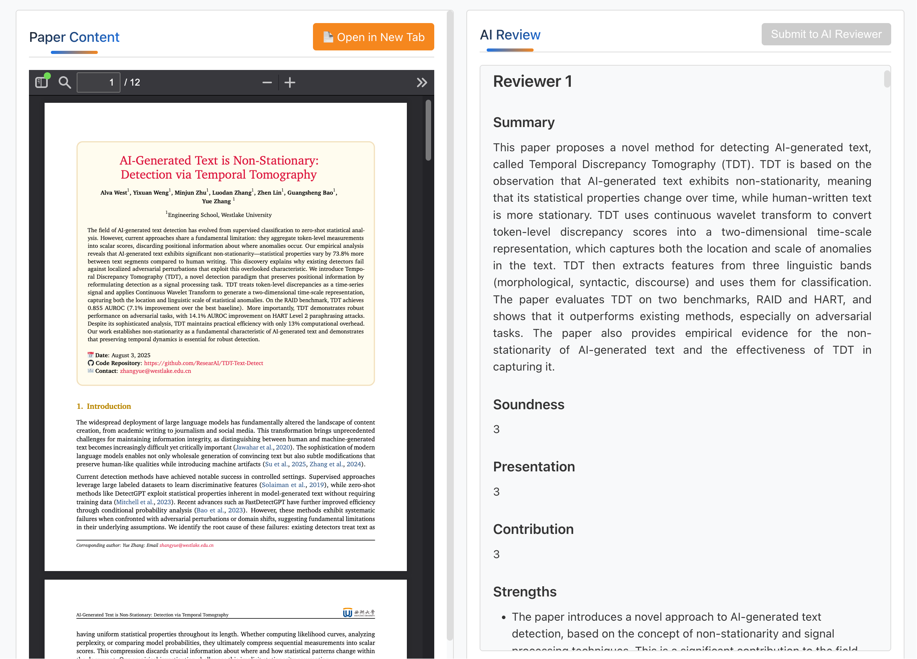


AiraXiv: The First Open-Access Archive Platform for AI-Generated Research
Open access and archiving of AI-generated research
Large reviewer models can provide peer review feedbacks
AI manages the flood of mixed-quality AI-generated papers, filtering high-quality research back to the human community.
https://airaxiv.com

Slide 31





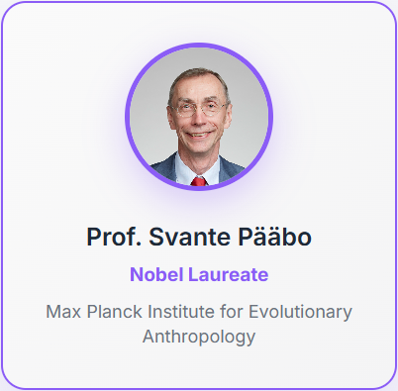

Support to the first International AI Scientist Conference
AI Review
AI Scientist
AiraXiv
6 Nobel Price Winners

Slide 32

AutoSurvey: Large Language Models Can Automatically Write Surveys
Yidong Wang*, Qi Guo*,
Wenjin Yao, Hongbo Zhang, Xin Zhang, Zhen Wu, Meishan Zhang,
Xinyu Dai, Min Zhang, Qingsong Wen, Wei Ye, Shikun Zhang, Yue Zhang
(yidongwang37@gmail.com)
Westlake
University

Slide 33
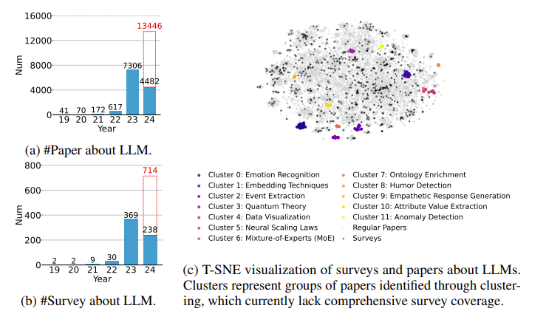
Background：explosion of papers about LLM
Data until April 2024
The manually written survey cannot cover all areas！

Slide 34
Need for automatic survey
Quick review of a new field
Overview of arXiv papers recommended
Challenge in using LLMs do conduct auto survey directly
Context too long
Paper reading and survey generation are slow

Slide 35
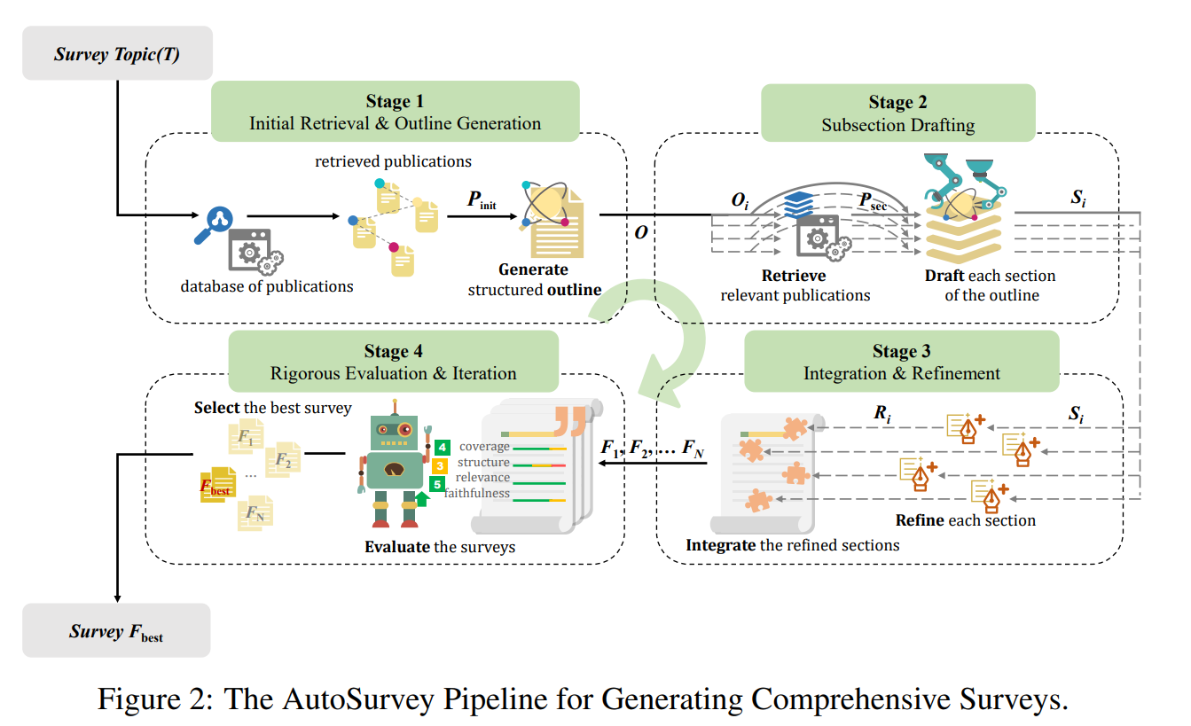
AutoSurvey
The AutoSurvey Pipeline for Generating Comprehensive Surveys
Initial Retrieval and Outline Generation
We use LangChain to build a database from 530,000 arxiv papers under CS. category and perform embedding-based retrieval of relevant publications
Generation of structured outlines ensuring comprehensive coverage.

Slide 36
AutoSurvey
The AutoSurvey Pipeline for Generating Comprehensive Surveys
Subsection Drafting
Specialized LLMs draft each section in parallel.
Focused content generation based on detailed sub-outlines.

Slide 37
AutoSurvey
The AutoSurvey Pipeline for Generating Comprehensive Surveys
Integration and Refinement
Refinement of individual sections for coherence and readability.
Merging sections into a cohesive final document.

Slide 38
AutoSurvey
The AutoSurvey Pipeline for Generating Comprehensive Surveys
Rigorous Evaluation and Iteration
Multi-LLM-as-judge evaluation for citation and content quality.
Iterative refinement to ensure high academic standards.

Slide 39
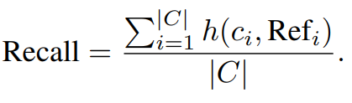
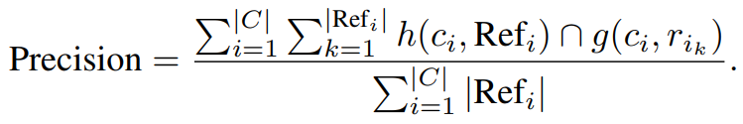
Need for Automatic Evaluation
For the drafting phase of AutoSurvey, we utilize Claude-3-Haiku, known for its speed and cost-effectiveness, capable of handling 200K tokens. For evaluations, we employ a combination of GPT-4, Claude-3-Haiku, and Gemini-1.5-Pro3
Survey Creation Speed：
Time: The time to generate a survey
Speed: 1/Time (hours)
Citation Quality：
Citation Recall：
Citation Precision：
Content Quality：
Coverage: Evaluate the extent to which the survey encapsulates all aspects of the topic.
Structure: Evaluate the logical organization and coherence of each section.
Relevance: Measure how well the content aligns with the research topic.
(Whether the references support the claim)
(whether the references include irrelevant citations)

Slide 40
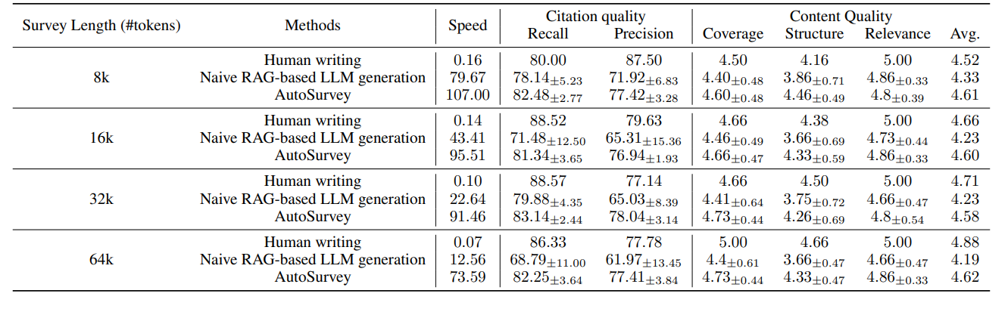
Evaluation of Generated Survey
Experiments data and results
data
We also used LLM generation without RAG as a baseline, but the effect was too poor and was not shown.
results：
Survey Creation Speed: AutoSurvey significantly outperforms both human writing and naive RAG-based LLM generation in terms of speed.
Citation Quality: High recall and precision, close to human writing.
Content Quality: Excellent coverage, structure, and relevance scores.

Slide 41
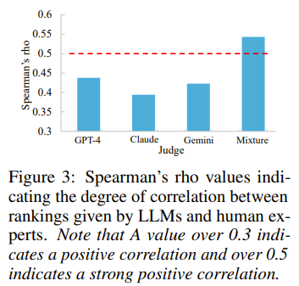
Meta Evaluation
Alignment with Human Evaluation:
A moderate positive correlation exists between the rankings provided by the LLMs and those given by the human experts, with the mixture of models achieving the highest correlation at 0.5429. These results suggest that our evaluation method aligns well with human preferences, providing a reliable proxy for human judgment.

Slide 42
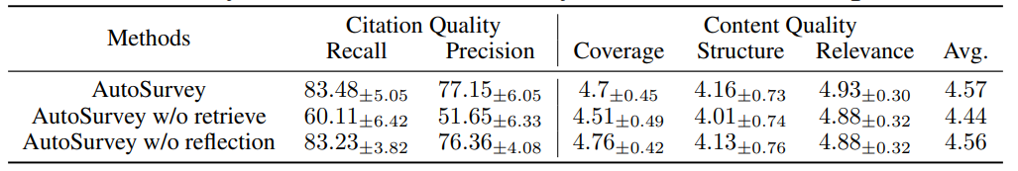
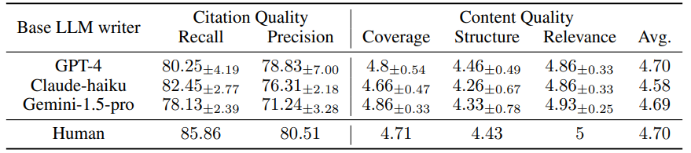
Ablation study
Systematically removing key components: the retrieval mechanism, the reflection phase.
the retrieval component plays a much more important role
Different base LLMs.
Even with a less optimal LLM like Claude-haiku, AutoSurvey performance remains comparable to human-generated surveys

Slide 43
Overview
literature survey
idea
generation
project
design
experimentation
write up
peer review
social impact
In this talk, I will share some work on:
The new publication paradigm
AI-driven research cycle
AI scientist for AI
AI scientist for natural science

Slide 44

CycleResearcher:
Improving Automated Research via Automated Review
Yixuan Weng*, Minjun Zhu*, Guangsheng Bao, Hongbo Zhang, Jindong Wang,
Yue Zhang, Linyi Yang
Westlake
University
http://ai-researcher.cn

Slide 45
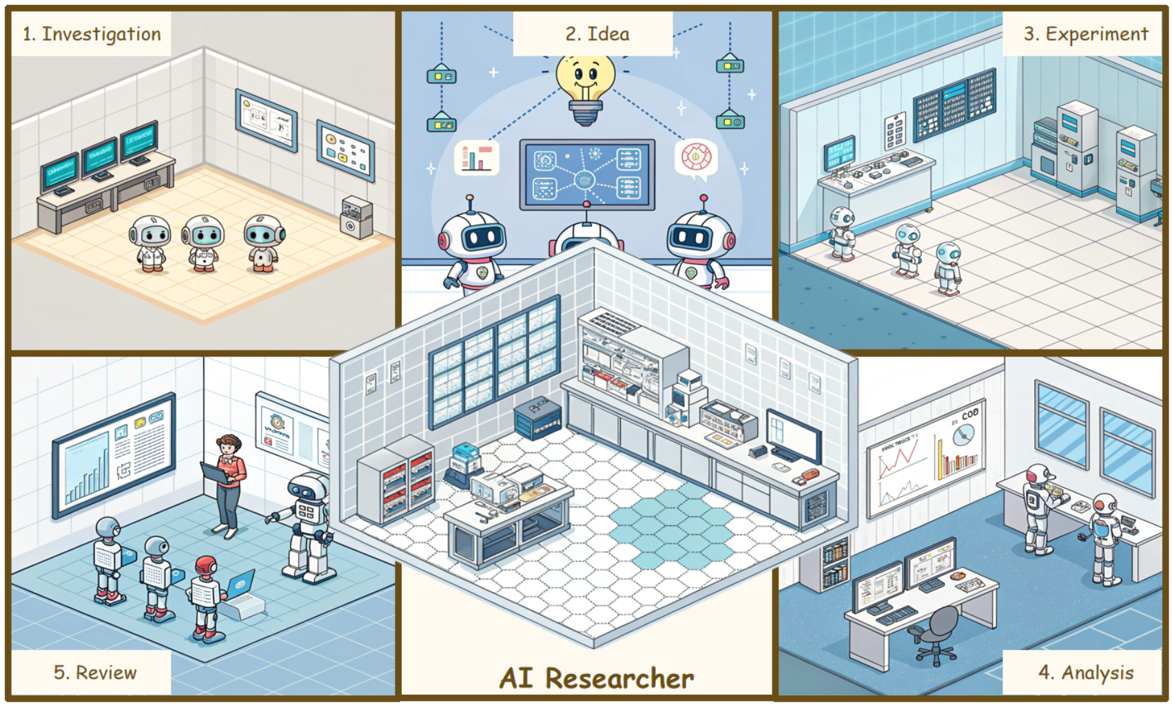
Research Question & Contributions
How can we automate the Research-Review-Refinement process by post-training LLMs?"
Dataset
Researcher-14K
Review-5K
DeepReview-13K
Iterative Reinforcement Learning framework
Reward model
Policy model
DeepReviewer-14B
CycleResearcher-12B
CycleResearcher-123B
http://ai-researcher.cn

Slide 46
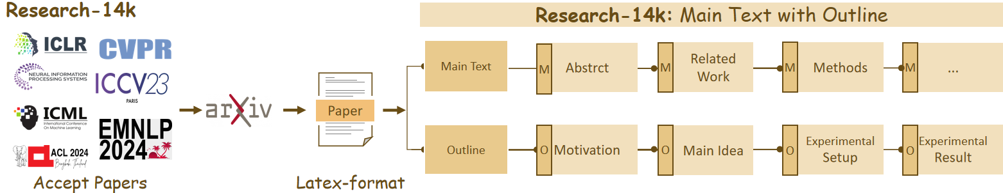
Research-14k: Data Collection and Supervised Fine-tuning
Main text (M): Full paper content
Outlines (O): Structured paper planning
Combined as a complete pipeline context for training
Research-14K
~14000 Accepted Papers
~28000 Tokens per Paper
From 2022 to 2024.
CycleResearcher Warmup: SFT
~1 month for 4 x 8 H100
Full Size: 7B/72B/123B
http://ai-researcher.cn

Slide 47
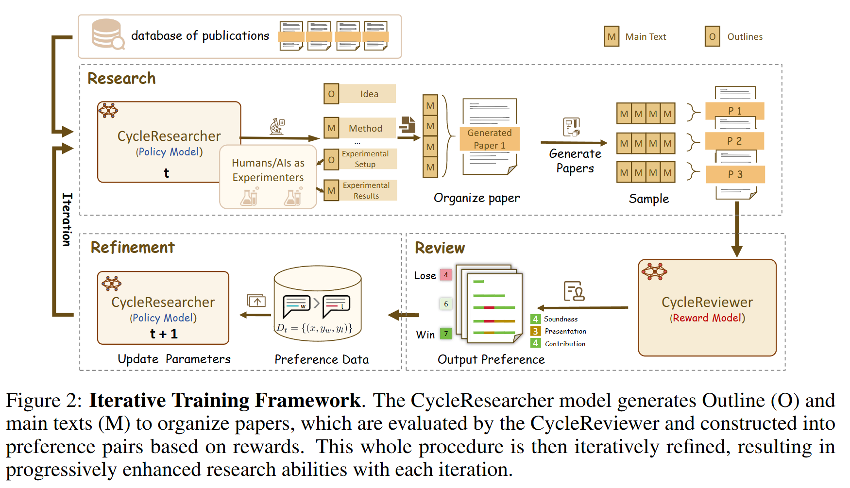
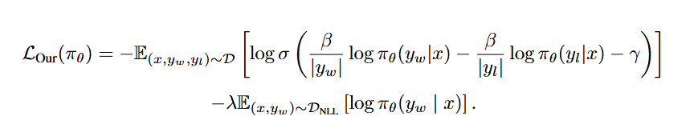
CycleResearcher RL Training: Research-Review-Refinement Cycle
RL Train
Iterative SimPO
RL Training
Research
Refinement
Review
http://ai-researcher.cn

Slide 48
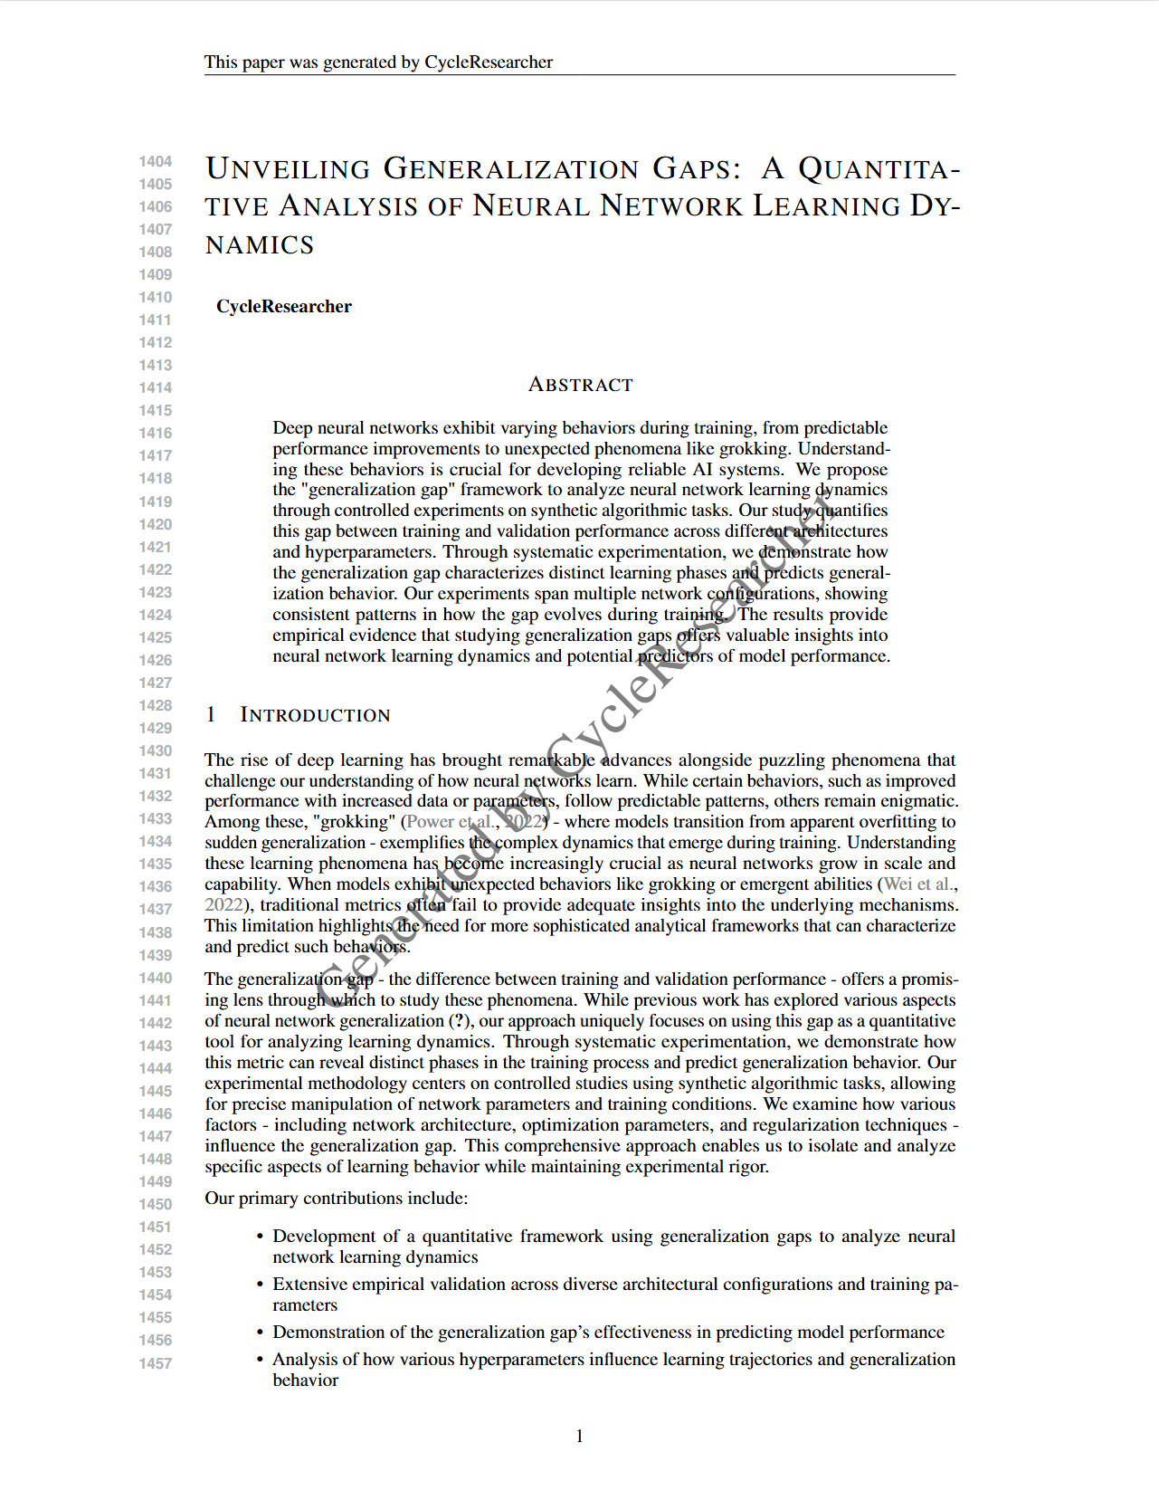
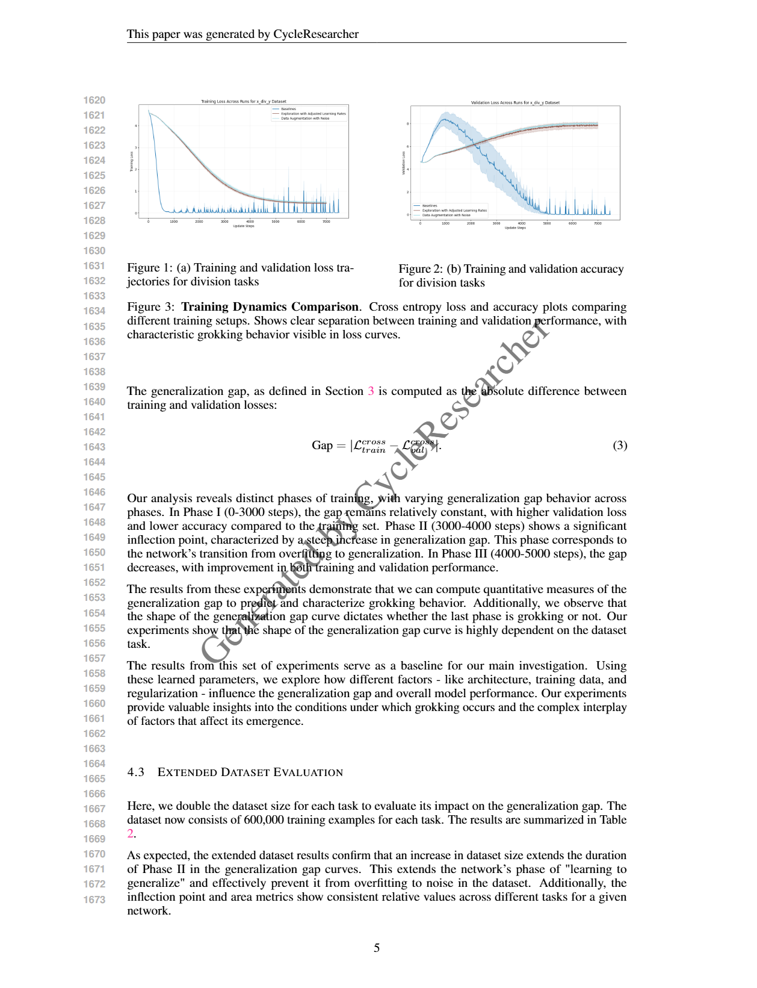
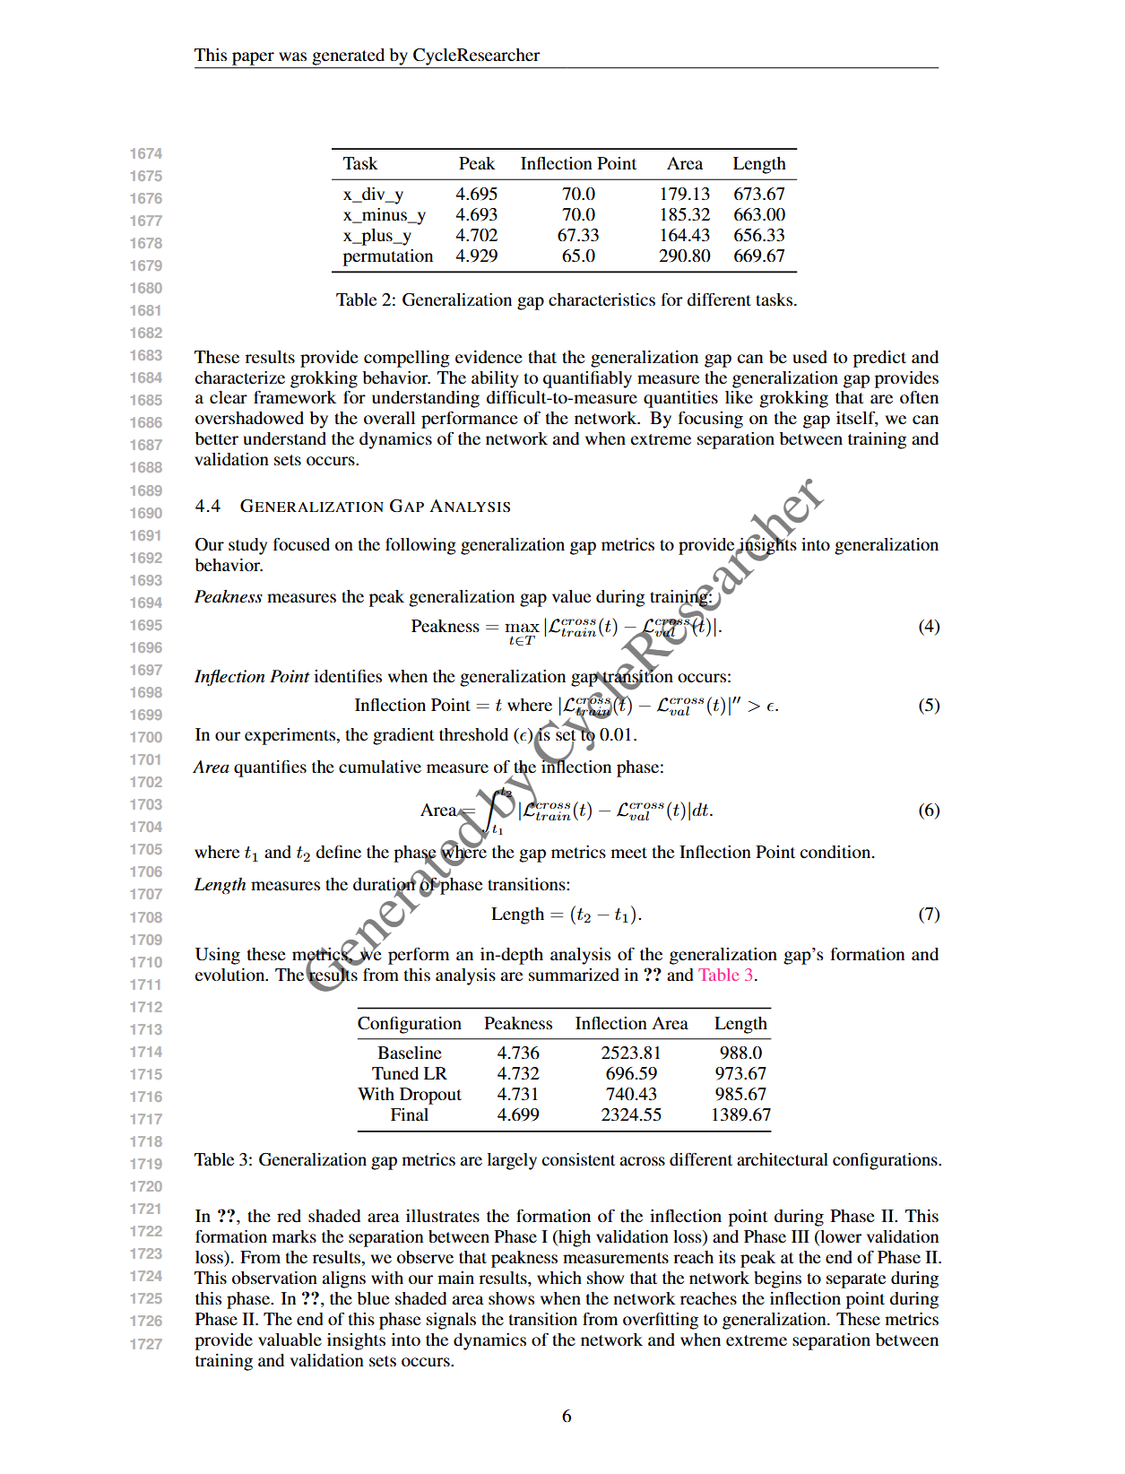
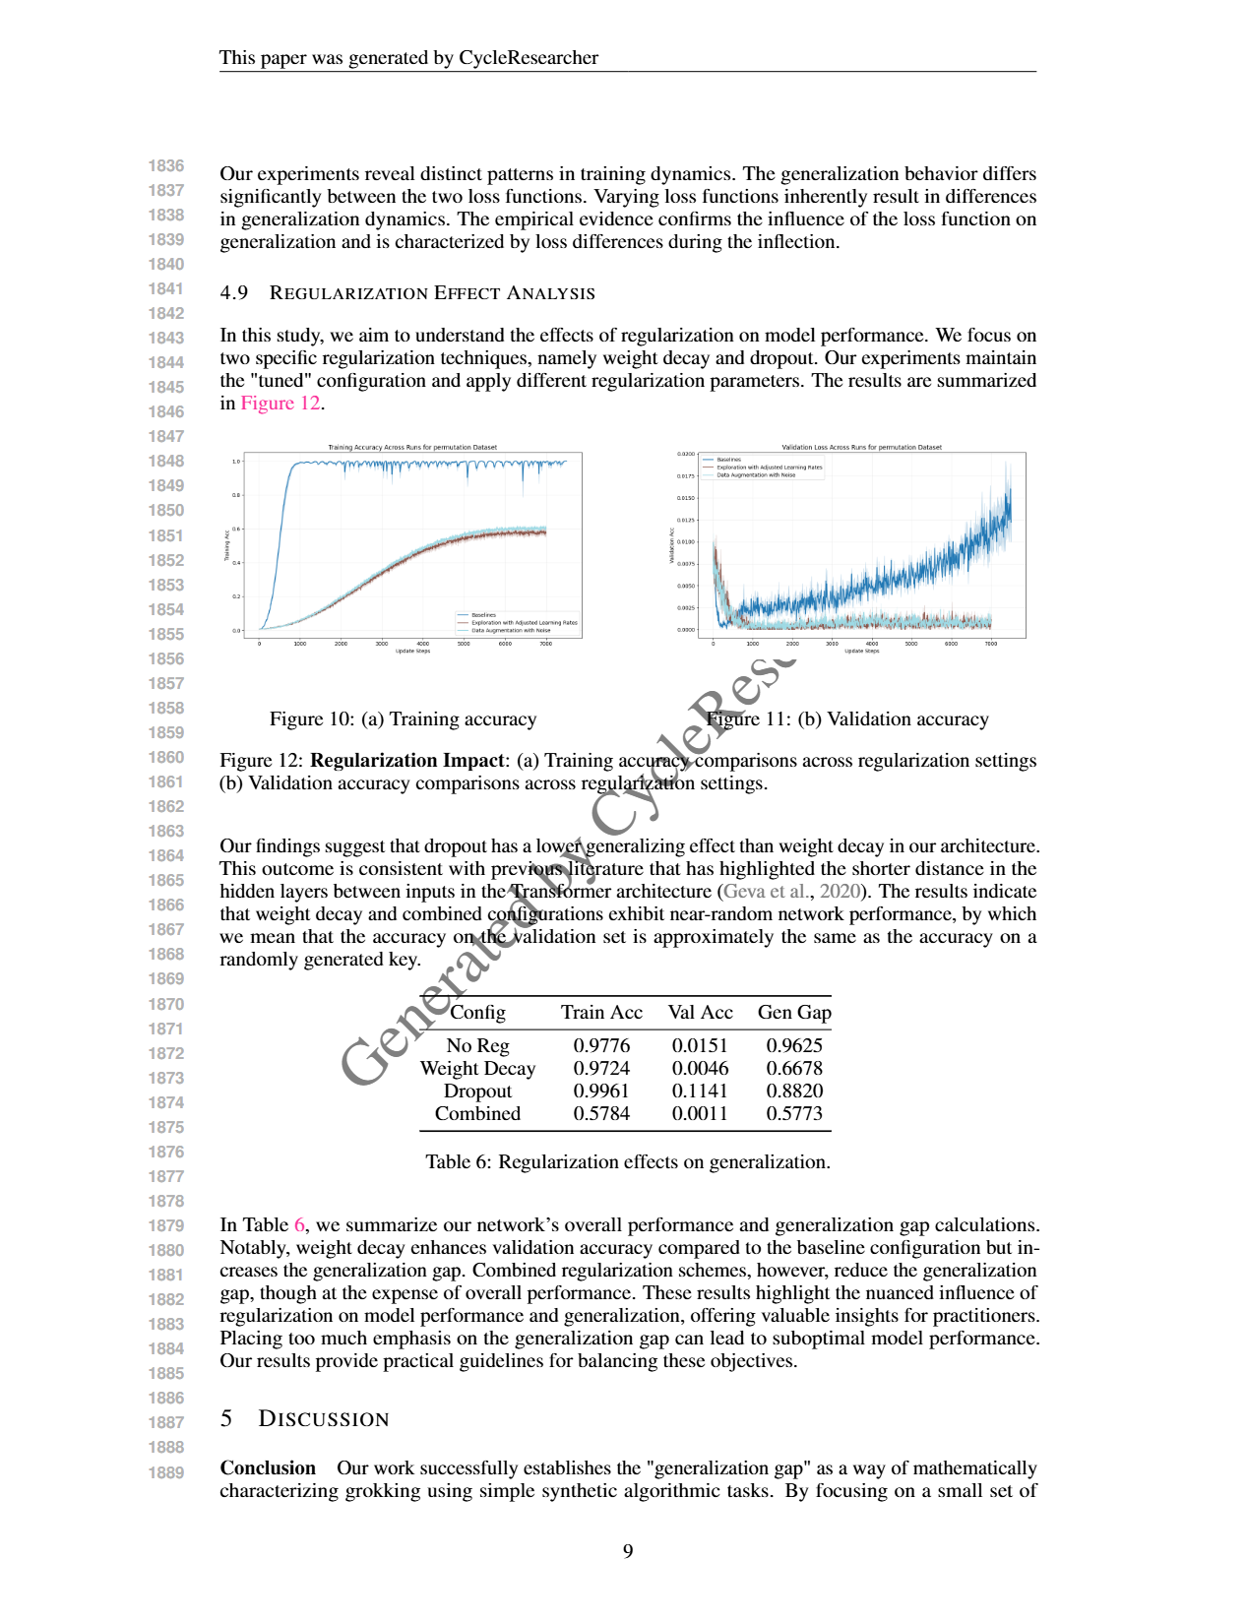
Example for CycleResearcher: Real-world process: Search + Code Generation + Experiments + Paper Writing
http://ai-researcher.cn

Slide 49
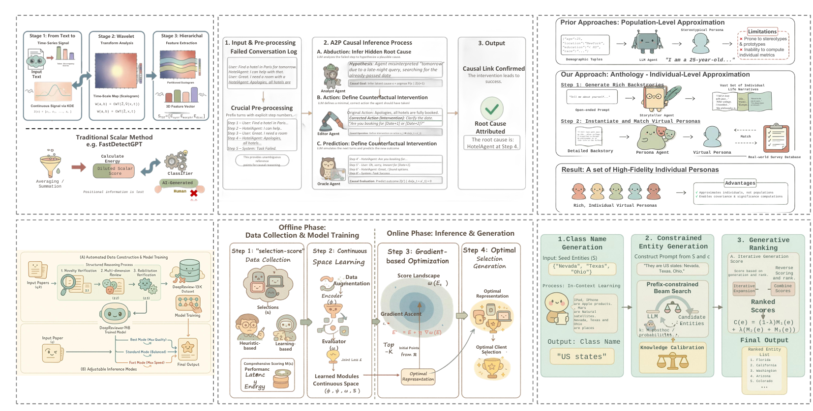
AutoFigure
Automatically generate publication-quality scientific figures.
http://ai-researcher.cn

Slide 50
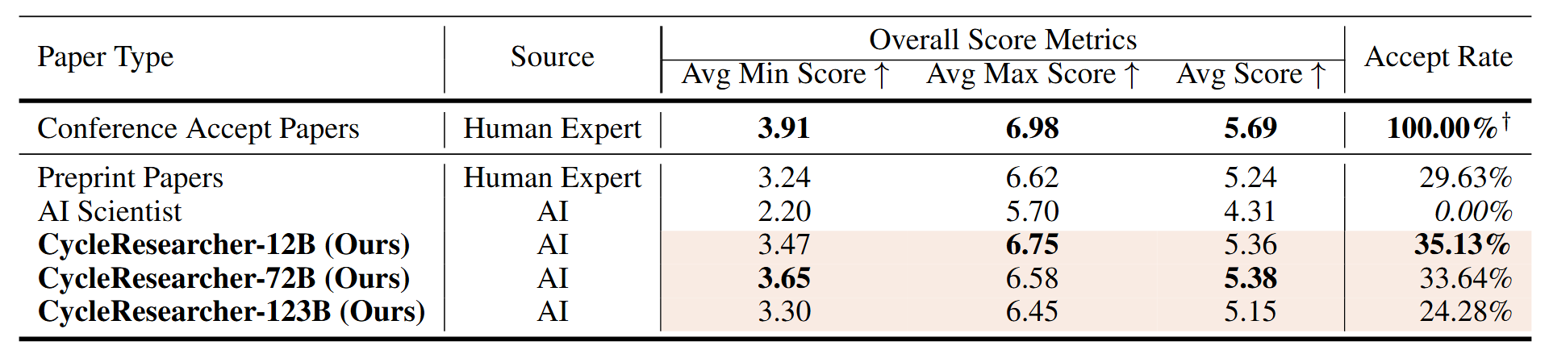
Main Experimental Findings: CycleResearcher
results：
CycleResearcher scores closer to human preprints than AI Scientist.
Generated papers show competitive quality metrics.
Score gap between AI and human experts narrowing.
http://ai-researcher.cn

Slide 51
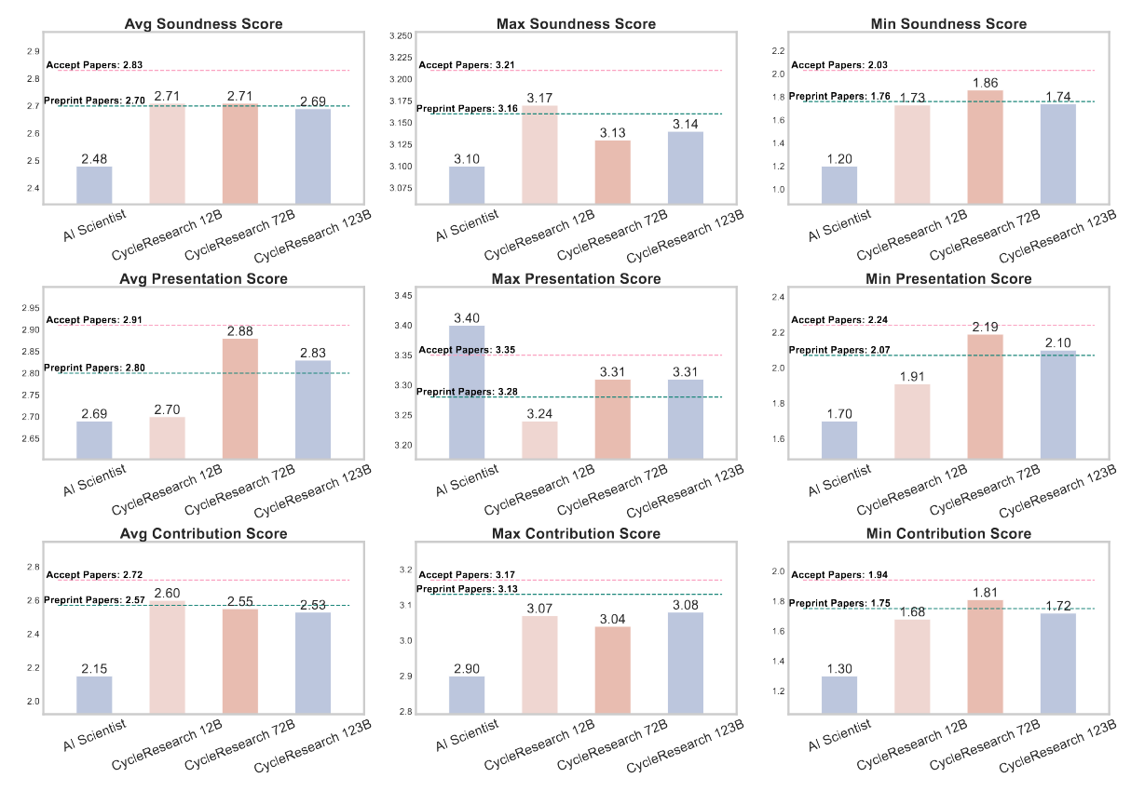
Main Experimental Findings: CycleResearcher
results：
Outperform AI Scientist across all metrics
72B model excels in presentation scores
12B model shows strongest contribution scores
All models approach preprint-level soundness
http://ai-researcher.cn

Slide 52
Overview
literature survey
idea
generation
project
design
experimentation
write up
peer review
social impact
In this talk, I will share some work on:
The new publication paradigm
AI-driven research cycle
AI scientist for AI
AI scientist for natural science

Slide 53
DeepScientist:
Advancing Frontier-Pushing Scientific Findings Progressively
Yixuan Weng*, Minjun Zhu*, Qiujie Xie, Qiyao Sun, Zhen Lin, Sifan Liu, Yue Zhang
Westlake
University
http://ai-researcher.cn
http://deepscientist.cc

Slide 54
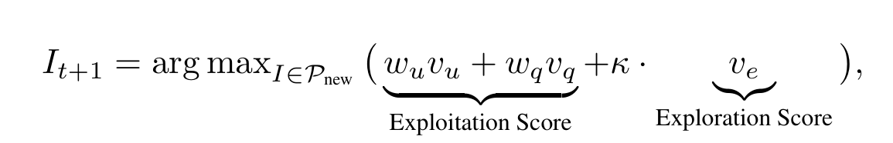
DeepScientist
Strategize & Hypothesize: The system analyzes its existing knowledge base to generate a multitude of new research ideas and then uses a low-cost "LLM reviewer" to rapidly perform an initial screening.
Implement & Verify: Using the UCB algorithm, the system selects the most promising idea and deploys a coding agent to implement it in a real codebase and validate its effectiveness through experimentation.
Analyze & Report: For a successfully validated discovery, the system conducts deeper analytical experiments and ultimately synthesizes all results to automatically write a complete research paper.
Model scientific discovery as Bayesian Optimization, where only promising findings advance to higher-fidelity validation, balancing exploration and exploitation.
http://ai-researcher.cn

Slide 55
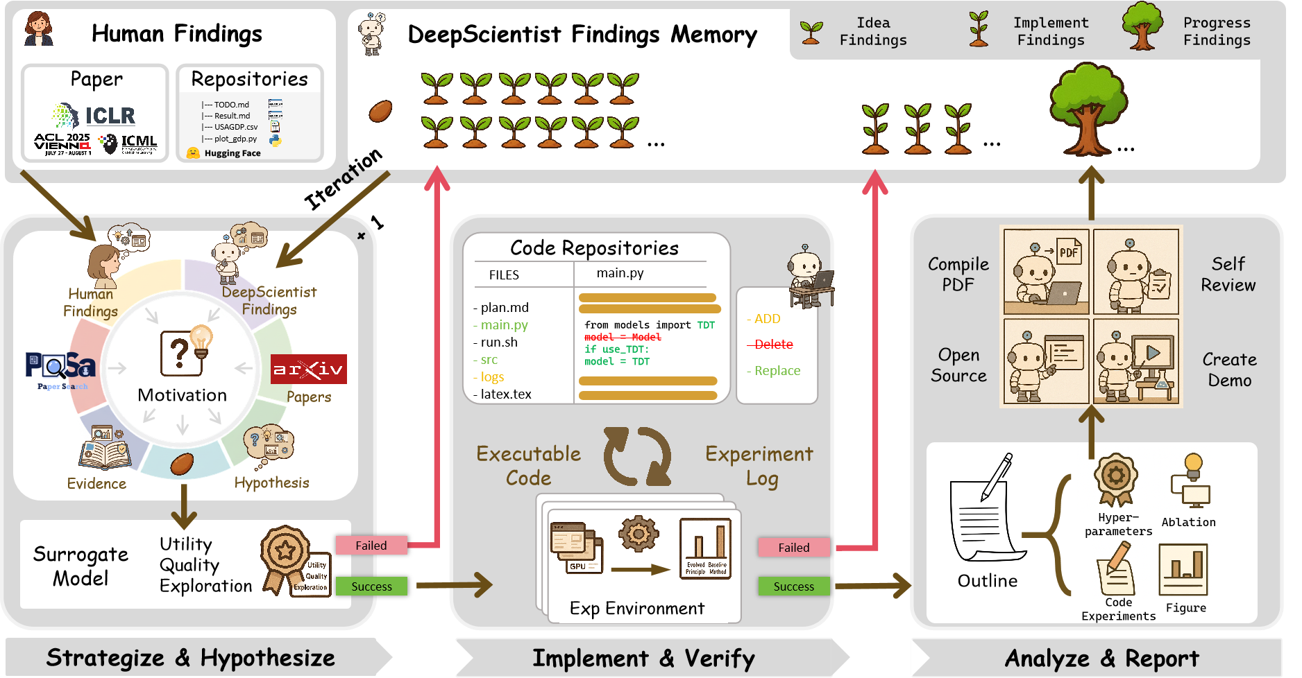
DeepScientist
Model scientific discovery as Bayesian Optimization, where only promising findings advance to higher-fidelity validation, balancing exploration and exploitation.
http://ai-researcher.cn

Slide 56
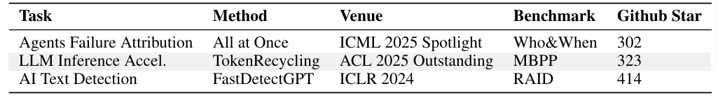
DeepScientist
Agent Failure Attribution: Identifying which agent in a multi-agent system caused a task to fail and when.
LLM Inference Acceleration: A field focused on maximizing throughput and reducing latency during LLM inference processing.
AI Text Detection: Determining whether a given piece of text was written by a human or an AI.
Selected three frontier tasks from human researchers as starting points for DeepScientist.
http://ai-researcher.cn

Slide 57
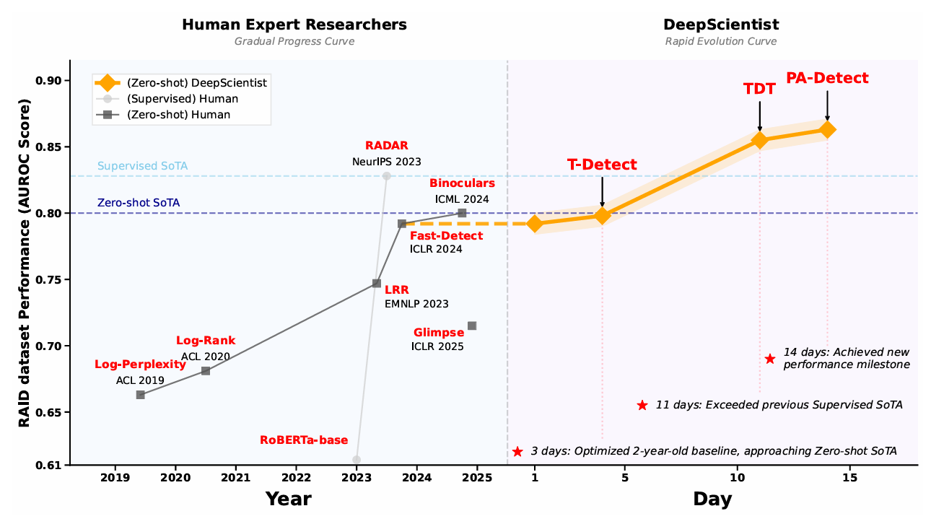
DeepScientist
http://ai-researcher.cn

Slide 58
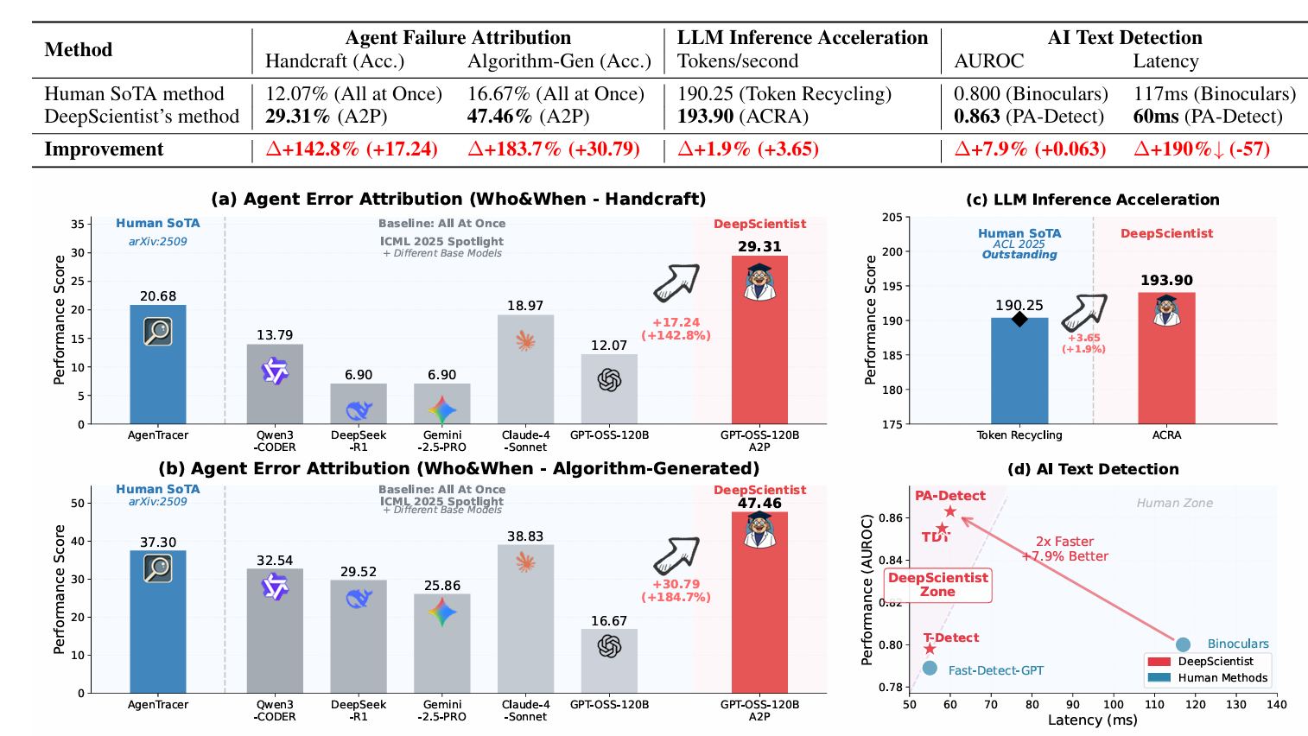
DeepScientist
Drives hundreds of studies in parallel, enabling large-scale discovery at a speed surpassing human experts.
http://ai-researcher.cn

Slide 59
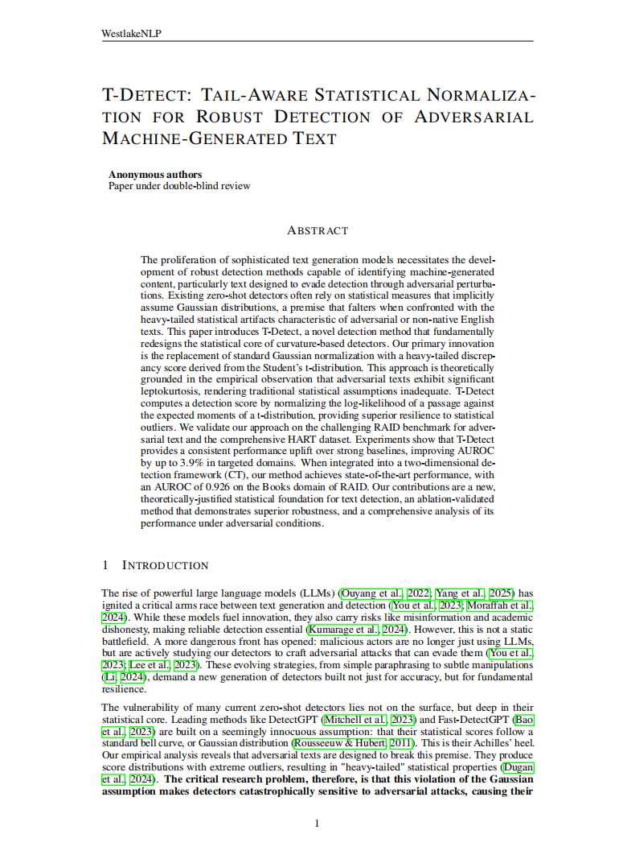
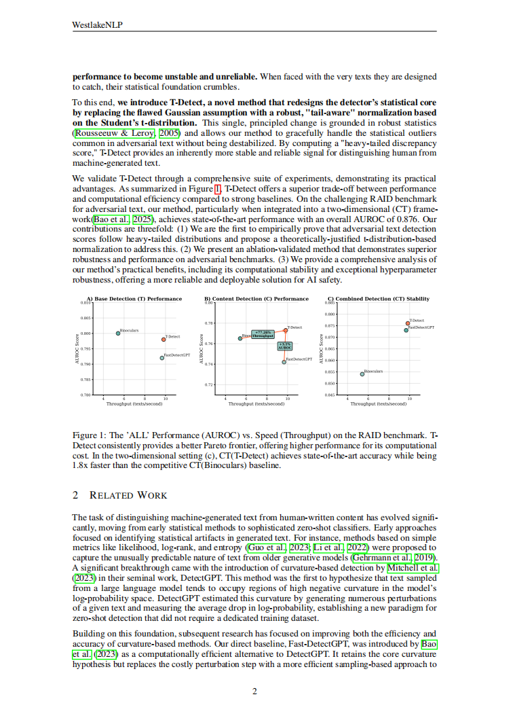
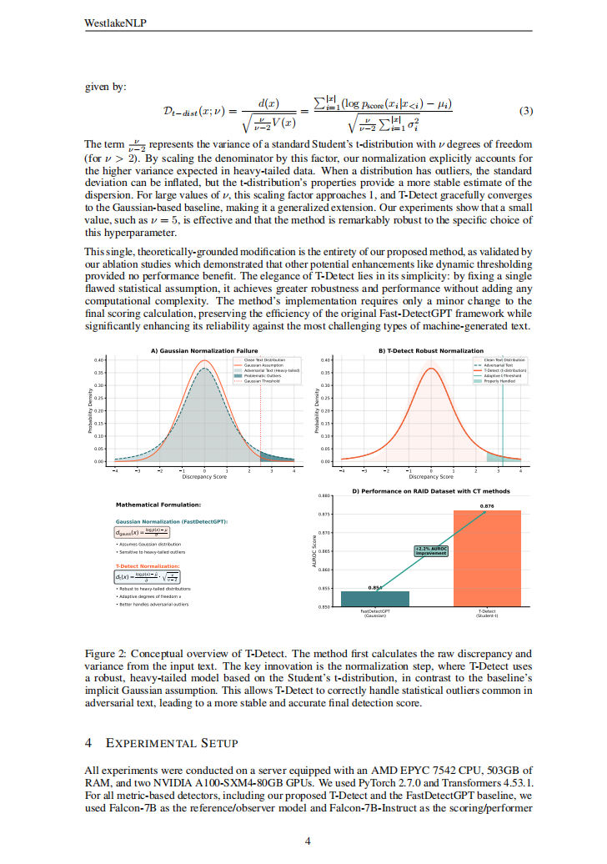
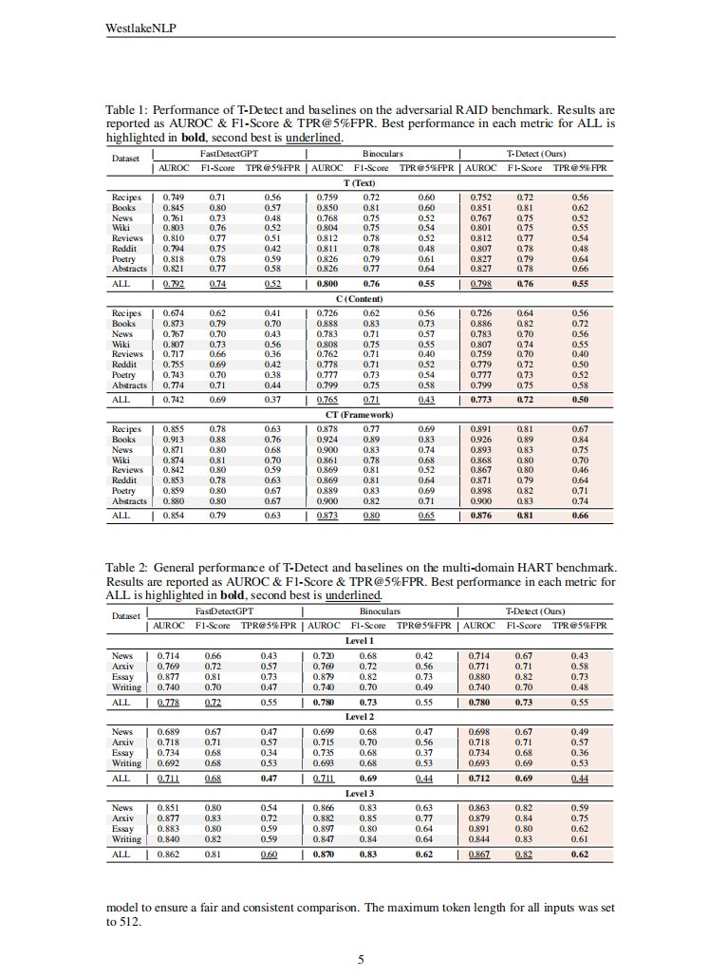



DeepScientist
Paper 1
Paper 2
Paper 3
Ultimately produces scientific findings and research papers that push the human frontier.
http://ai-researcher.cn

Slide 60
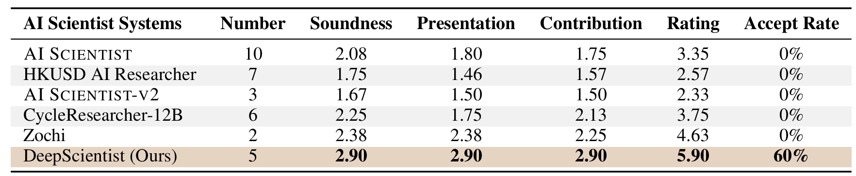
DeepScientist
AI Reviewer
DeepReviewer-14B
AI and human evaluations show that papers generated by DeepScientist are nearly on par with the average ICLR submission.
http://ai-researcher.cn

Slide 61
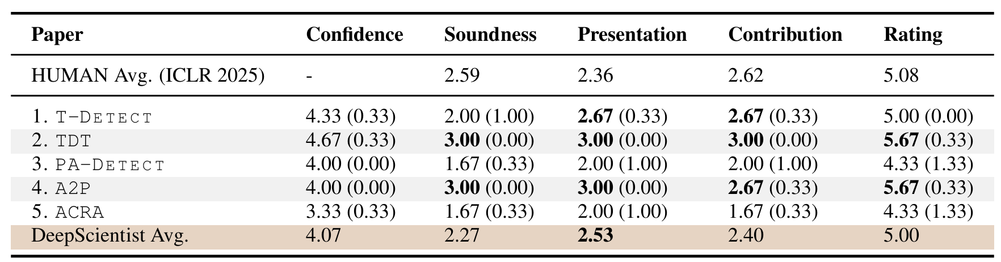
DeepScientist
Human Reviewer
2 ICLR Reviewers
1 ICLR Area Chair
AI and human evaluations show that papers generated by DeepScientist are nearly on par with the average ICLR submission.
http://ai-researcher.cn

Slide 62
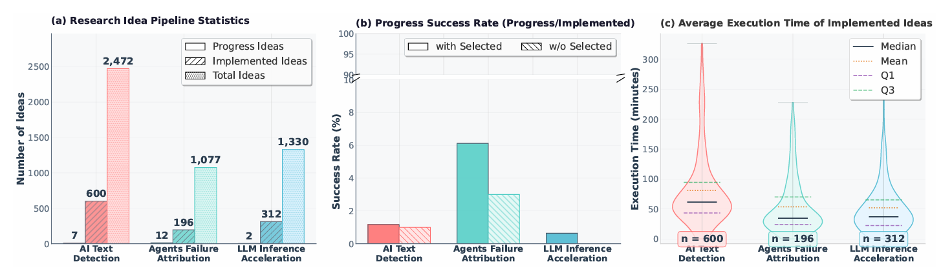
DeepScientist
Producing genuinely impactful research is challenging
http://ai-researcher.cn

Slide 63
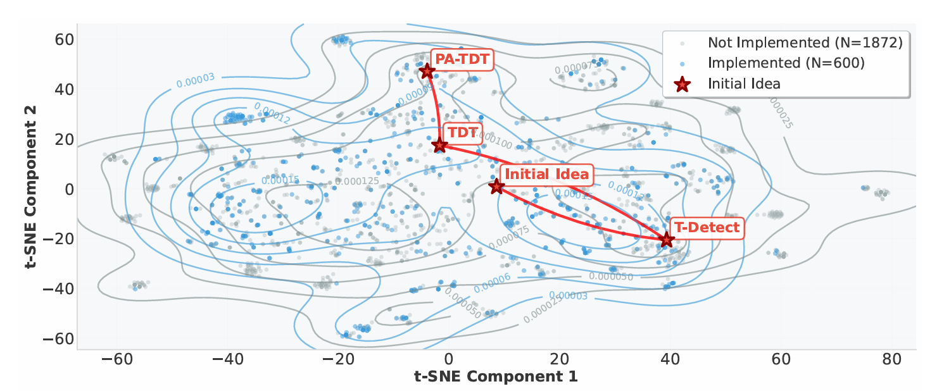
DeepScientist
After a breakthrough, the agent forms a closed feedback loop, using the new finding as a starting point to continuously push the frontier.
http://ai-researcher.cn

Slide 64
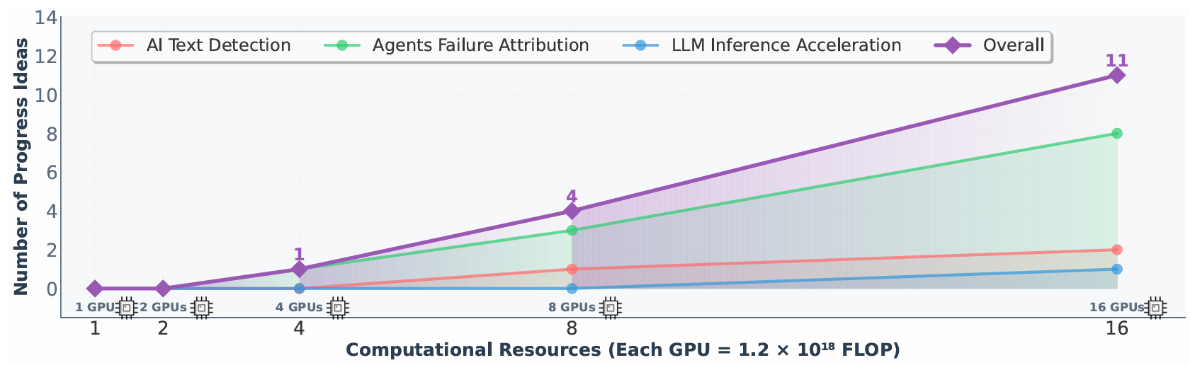
DeepScientist
First to empirically demonstrate a scaling law for scientific discovery: discovery efficiency increases near-linearly with computational resources.
http://ai-researcher.cn

Slide 65

DeepScientist-CLI
The first CLI toolkit to operationalize a complex autonomous discovery system
like DeepScientist, runnable on any GPU server!
http://ai-researcher.cn

Slide 66
Overview
literature survey
idea
generation
project
design
experimentation
write up
peer review
social impact
In this talk, I will share some work on:
The new publication paradigm
AI-driven research cycle
AI scientist for AI
AI scientist for natural science

Slide 67


Airalogy: The world's first universal platform for
research digitization, automation, and acceleration
across all disciplines
Zijie Yang*, Qiji Zhou*, Fang Guo*, Sijie Zhang, Yexun Xi, Jinglei Nie, Yudian Zhu, Liping Huang, Chou Wu, Yonghe Xia, Xiaoyu Ma, Yingming Pu, Panzhong Lu, Junshu Pan, Mingtao Chen,
Tiannan Guo#, Yanmei Dou#, Hongyu Chen#, Anping Zeng#, Jiaxing Huang#, Tian Xu#, Yue Zhang#
arXiv, 2025
Now available worldwide: https://airalogy.com
Notes:
In this short video, I will introduce an innovative research work that was recently published. In this study, researchers from Westlake University developed an AI-driven research platform called Airalogy. Airalogy is the world’s first universal platform that can be applied across all disciplines, promoting research digitization, automation, and acceleration.

Slide 68





Strategic AI development will accelerate innovation But a lack of high-quality scientific data remains the bottleneck
Data is the foundation of both AI and science
Current AI-driven research still centers on fields with public, standardized datasets
Solution
Develop a universal platform that digitizes all data generated throughout research workflows across all disciplines
With the help of AI: users can easily design record forms for any discipline without requiring computer expertise
Only
Protein Structure Prediction¹
Drug Discovery²
8%
Research is AI-empowered⁵
Pathology Image Recognition³
Materials Discovery⁴
¹ AlphaFold. Nature, 2021
² Halicin. Cell, 2020
³ PathChat. Nature, 2024
⁴ A-Lab. Nature, 2023
⁵ A survey of 1,600 researchers. Nature, 2023
Now available worldwide: https://airalogy.com
Notes:
Strategic development and application of AI can significantly accelerate scientific and technological innovation. However, current AI-empowered research mainly centers on fields with publicly available, well-structured datasets. For example, in protein and materials design, data are relatively standardized and structured, with large public repositories such as the Protein Data Bank (PDB) providing a solid foundation for AI development.
Apparently, research fields are highly diverse. And in many fields not covered by public datasets, AI-enabled research remains very limited. This is primarily because obtaining high-quality data in these fields is both difficult and costly.
To address this challenge, one solution is to develop a universal platform that digitizes all data generated throughout research workflows across all disciplines. Moreover, since many researchers have expertise only in their own domain and not in computer science, such a platform should leverage AI assistance—allowing users to easily define record forms for any discipline without requiring technical expertise.

Slide 69






















Building a universal AI-driven platform for research digitization, automation, and acceleration Deep collaboration with 7 leading labs across all four schools of Westlake University
Yue Zhang
School of Engineering Professor
AI/NLP Expert
Tian Xu
Life Sciences Chair Professor
Founding Vice President,
Westlake University
Jiaxing Huang
Engineering Chair Professor
Member, European Academy
of Sciences and Arts
Anping Zeng
Engineering
Chair Professor
Member, German Academy of Engineering
Hongyu Chen
Science
Professor
Fellow, Royal Society of Chemistry
Tiannan Guo
Medicine
Asso. Professor
Director, Westlake Center for Intelligent Proteomics
Yanmei Dou
Life Sciences
Assi. Professor
Computational Biology Expert
Zijie Yang
Qiji Zhou
Fang Guo
Sijie Zhang
Yexun Xi
Jinglei Nie
Yudian Zhu
Liping Huang
Chou Wu
Yonghe Xia
Xiaoyu Ma
Yingming Pu
Mingtao Chen
Panzhong Lu
Junshu Pan
The first research in Westlake University's history which involves all four schools simultaneously
Now available worldwide: https://airalogy.com
Notes:
To achieve this goal, we assembled a research team that brings together seven leading laboratories across all four schools of Westlake University. By carefully studying the research needs of laboratories in different disciplines, we developed Airalogy—an AI-driven, universal platform for research digitization, automation, and acceleration.
This project also marks the first research effort in Westlake University’s history to involve all four schools simultaneously.

Slide 70

Illustrating traditional ways for recording research data Click chemistry reaction as an example
Way 1
Handwritten
Undigitized
Way 2
Generic tool
(such as Word)
Universal but not structured
Way 3
Centrally designed tool
(predefined template by the tool)
Structured but not universal
Recorder | YANG Zijie
Time | 2025-10-16 8:00
Reaction | Phenylacetylene + Benzyl azide
Solvent | t-BuOH/H2O (1:1)
Temperature (℃) | 25.0
Catalyst | CuSO4/NaAsc
Limiting substrate A | Phenylacetylene
A initial concentration (mM) | 50.0
Excess substrate B | benzyl azide
Hard to read handwriting
Personal notes others cannot understand
Inconsistent formats
Key data cannot be effectively extracted
Cannot provide templates in time for every cutting-edge research
Template developers cannot master the needs and expertise of all disciplines

Slide 71

Core challenge in developing a multidisciplinary digitization platform: Balancing universality and standardization
Community-driven: Researchers customize their own experimental protocols, data standards (what data to record and how to record it), and ready-to-use automated data processing and analysis methods for their research.
AI-driven: The platform provides a general AI research assistant, Aira. Based on researchers' needs, Aira automatically designs experimental protocols and offers real-time guidance, enabling researchers without programming backgrounds to use it with ease.
Now available worldwide: https://airalogy.com
Notes:
Concerning universality, many laboratories at Westlake use generic tools such as text editors to document experimental data, without much consideration for standardization. However, when researchers record data in plain text, different individuals adopt different styles and habits. As a result, while such tools are highly universal, they lack the standardization essential for effective data extraction and inter-laboratory sharing.
Concerning standardization, some centralized platforms provide a set of pre-defined protocol templates for common experiments. Yet even so-called “standard” experiments often have many variations. For instance, different methods of protein purification require documenting different parameters. A single platform built on fixed templates cannot feasibly meet every specialized need. Furthermore, scientific research spans a wide range of disciplines, and laboratory practices not only differ significantly across fields but also evolve rapidly with scientific advances. For example, one of our participating labs pioneered a method for synthesizing gold nanopropellers in 2024. Since its experimental procedures were newly developed, no existing protocol could capture them. Thus, attempting to create pre-defined templates for every niche experiment is neither financially nor logistically feasible.
To address these challenges, we developed a unique solution by combining both community-driven and AI-driven design principles in the Airalogy platform.
In brief.
From the community-driven perspective, researchers can customize research protocols and define data standards tailored to their own studies. From the AI-driven perspective, Airalogy provides an advanced AI research copilot that automates protocol design and application—making it easy for researchers without programming expertise to use.

Slide 72

Illustrating traditional ways for recording research data Click chemistry reaction as an example
The Nobel Prize in Chemistry 2022 was awarded to Click Chemistry
Substrate A
Substrate B
Highly selective product
Now available worldwide: https://airalogy.com
Notes:
张老师您介绍的时候只需要说Click Chemistry（点击化学）的精髓在于底物A和底物B在加入合适催化剂后可以以高选择性、高反应效率生成目标产物

Slide 73


Using Airalogy Protocol to digitize research data in a both customizable (universal) and standardized manner
← String
← Date & time
← Number
Raw code for defining the Protocol
Users can easily customize which Fields to include in an Airalogy Protocol to record key data in a structured way and define each Field's data type and standard
Design once, share and reuse globally!
Protocol global link: https://airalogy.com/labs/airalogy/projects/public_protocols/protocols/cuaac_kinetics/protocol
Now available worldwide: https://airalogy.com

Slide 74

Community-Driven: Airalogy Hub Protocols designed once can be shared and reused worldwide
Now available worldwide: https://airalogy.com

Slide 75


Representative real-world application of Airalogy: Facilitating cutting-edge research and experiment sharing
Now available worldwide: https://airalogy.com

Slide 76

Representative real-world application of Airalogy: Facilitating cutting-edge research and experiment sharing Providing more detailed and intuitive experimental guidance
Original paper（JACS, 2024）
Airalogy Protocol
Now available worldwide: https://airalogy.com

Slide 77

Representative real-world application of Airalogy: Facilitating cutting-edge research and experiment sharing 24/7 guidance by AI mentor (provided by the Airalogy)

Slide 78

Representative real-world application of Airalogy: Facilitating cutting-edge research and experiment sharing Airalogy Protocol allows integrating multimodal LLM to automate the evaluation of experimental data
Now available worldwide: https://airalogy.com

Slide 79




Another Representative Airalogy Use Case (in bioengineering) As a One-Stop, Automated Platform for Research Data Collection, Management, and Utilization
Auto calculate parameters
Auto visualize data
Auto generate research reports via embedded LLM
Now available worldwide: https://airalogy.com

Slide 80


Slide 81

Access now!
Now available worldwide
https://airalogy.com

Slide 82
Overview
literature survey
idea
generation
project
design
experimentation
write up
peer review
social impact
With AI research automation, we aim at
Solving challenges more efficiently
Making experimental results more transparent and more reproducible
Renovating the publication paradigm by `publication on demand’
Facilitating knowledge exchange by recommendation
Allowing global research collaborations by data sharing

Slide 83


Slide 84


Slide 85


Slide 86
Thanks!

